Slide 1
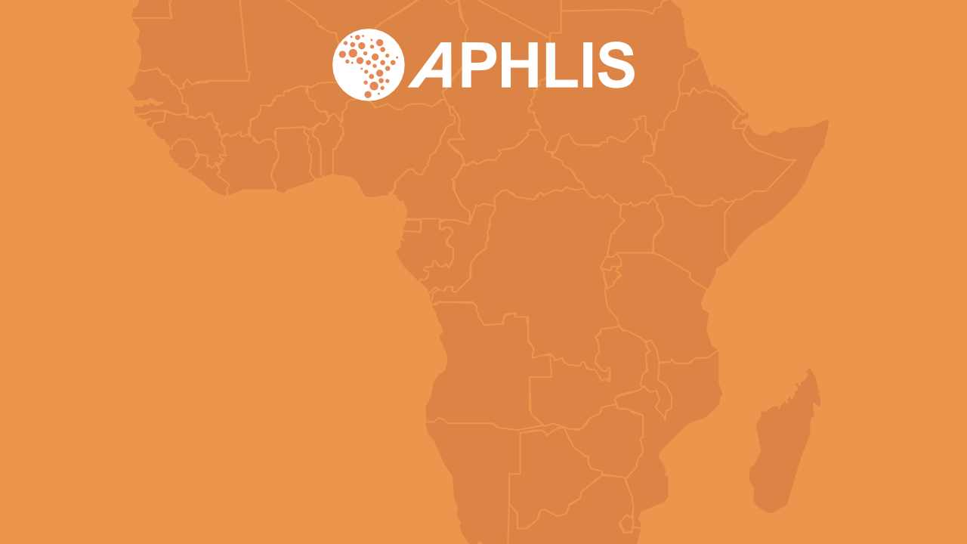
How APHLIS helps countries meet their postharvest loss reduction commitments
The African Postharvest Losses Information System
www.aphlis.net

Slide 2

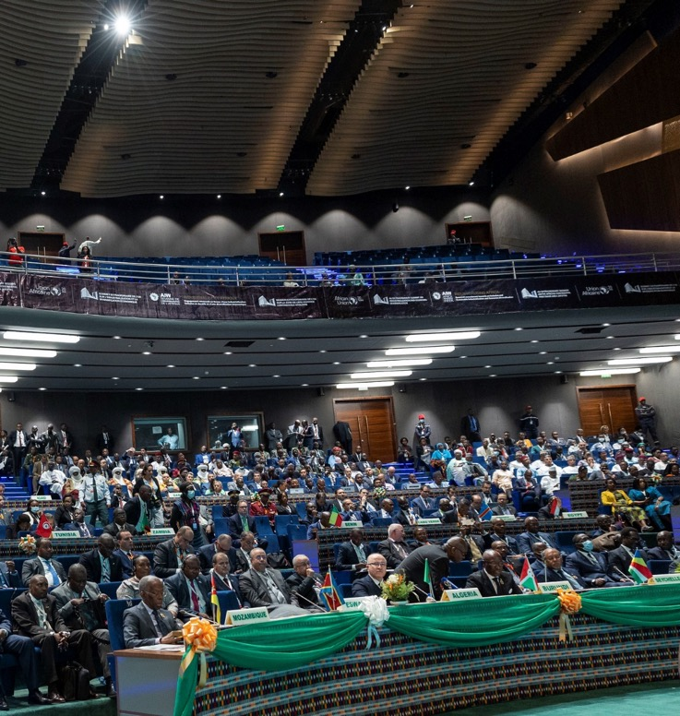
The Malabo Declaration
In June 2014, the African Union Assembly adopted the Malabo Declaration on Accelerated Agricultural Growth
A target to reduce postharvest losses by half is included under the commitment to end hunger in Africa by 2025
It aims to limit degradation in quantity and in quality of food at all stages of the food chain (harvest, storage, transport, processing, retail market)
Photo: Extraordinary Summit of the African Union by Paul Kagame
www.aphlis.net
Notes:
The Comprehensive Africa Agriculture Development Programme (CAADP) is Africa’s policy framework for agricultural transformation, food security and nutrition, economic growth, and prosperity.
To mark CAADP’s tenth anniversary in 2014, the African Union (AU) Heads of State and Government declared the Year of Agriculture and Food Security, a chance to consider achievements and lessons learned over CAADP’s first decade.
This led to the adoption of the Malabo Declaration on Accelerated Agricultural Growth and Transformation for Shared Prosperity and Improved Livelihoods by the AU Assembly in June 2014.
The Declaration includes a major commitment to end hunger in Africa by 2025.
Among other targets, signatory countries pledged to halve 2015 levels of postharvest losses by the year 2025. The aim was to limit degradation in quantity and quality of produced food at all stages of the food production chain (harvest, storage, transport, processing, market).
The AU Commission requires member states to report on progress made in reducing postharvest losses, as part of their biennial reporting on the Malabo commitments.
Member States are also expected to develop postharvest loss reduction strategies that are consistent with their Malabo Declaration postharvest loss reduction goals.

Slide 3
Country challenges
According to the AU Commission, a number of challenges limit the ability of countries to meet their Malabo commitments:
Limited awareness about PHL
Lack of PHL policies and strategies
Limited capacity in PH management
Inadequate PHL research and development
Lack of knowledge about how to measure PH losses
Inadequate storage technologies
Lack of appreciation of impact of PHL
Lack of adequate financing for PHL reduction actions
www.aphlis.net
Notes:
In a 2018 report, the African Union Commission identified a number of challenges that limit the ability of countries to meet their Malabo commitments on postharvest losses, including the lack of:
awareness about postharvest losses, including causes, impacts and solutions;
postharvest loss reduction policies and strategies at the national level;
institutional capacity in postharvest loss management;
research and development on postharvest losses;
knowledge about postharvest loss measurement methodologies;
postharvest storage technologies that limit losses;
appreciation of the economic value of postharvest losses and their impact on nutrition and food security; and
targeted financing and investment in postharvest loss reduction activities.

Slide 4
Biennial Review reporting
20
Member States reported data on losses in 2022
11
Member States met the 2020 milestone to reduce losses by 25%
The postharvest component of the CAADP Biennial Review (BR) Report monitors progress made by the 55 AU Member States in achieving Malabo Commitment 3: reduction of post-harvest losses by 50% by the year 2025
www.aphlis.net
Notes:
The Biennial Review (or BR) process includes self-reported data from the AU’s 55 members – beginning in 2017 – to capture progress on agricultural transformation.
The 3rd CAADP BR was issued in 2022. Of the 20 Member States that reported data on postharvest losses of priority commodities, only 11 were on-track to meet the 2020 milestone to reduce postharvest losses by at least 25 percent.
The report recommended that Member States build capacity, not only in reducing postharvest losses, but also in reliably estimating and reporting losses at the different segments of the postharvest phase.
This was reinforced at a policy roundtable during the 3rd All Africa Postharvest Loss Conference and Exhibition (AAPHCE) in September 2021, where countries identified the lack of comprehensive postharvest loss data as a major impediment to establishing effective postharvest loss policies.

Slide 5
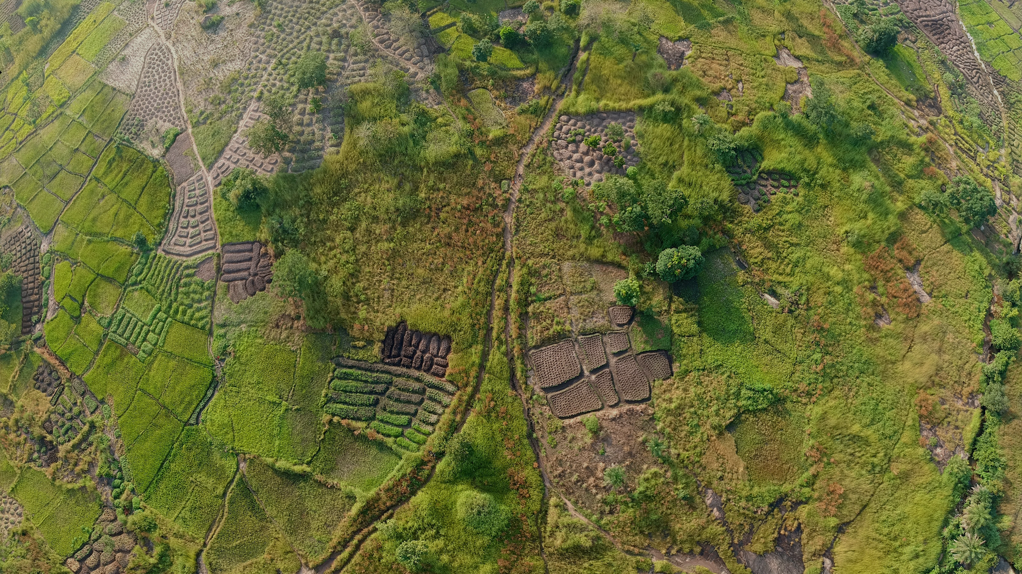
The African Postharvest Losses Information System (APHLIS) is the foremost international effort to collect, analyse and disseminate data on postharvest losses of cereal grains, legumes, roots and tubers in sub-Saharan Africa
www.aphlis.net
Notes:
Established in 2009, the African Postharvest Losses Information System, APHLIS is the leading source of scientific estimates of postharvest loss in African countries, including the nutritional and financial impact of these losses.
Backed by expertise in agricultural research, value chain development, postharvest management, commodity quality analysis, and policy development, APHLIS generates information on the postharvest losses of cereal grains, legumes, roots and tubers.

Slide 6
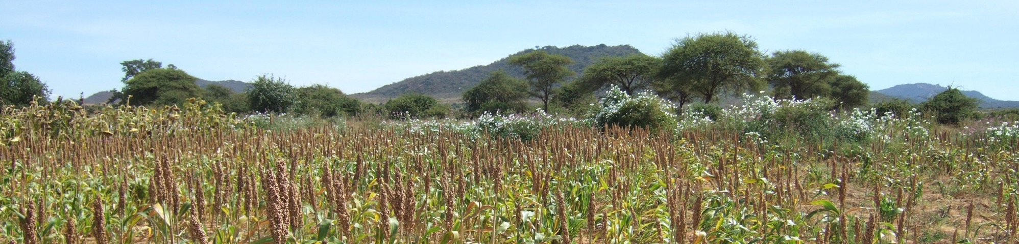
APHLIS objectives
Support
the development of national postharvest loss management strategies
Help
countries meet their Malabo and SDG postharvest loss reduction commitments.
Supply
decision-makers with the data they need to determine where and how to focus loss reduction efforts
Improve
the efficiency of value chains and support food security planning
Provide
the basis for monitoring and evaluating loss reduction programmes
Notes:
APHLIS objectives
to support the development of national postharvest losses strategies;
to help countries meet their postharvest loss reduction commitments;
to provide decision-makers with the data they need to determine where and how to focus loss reduction efforts;
to improve the efficiency of value chains and support food security planning;
to provide the basis for monitoring and evaluating loss reduction programmes.

Slide 7

APHLIS extracts PHL data from scientific literature to produce loss estimates at each stage of the postharvest value chain
↓
How APHLIS works →
www.aphlis.net
← To refine the loss estimates, national experts and statistics officers provide context-specific information on:
Subnational production data
Prevalent
pests
Weather conditions
Storage
duration
Percentage marketed
Common PHL loss reduction practices
Notes:
APHLIS calculates postharvest loss estimates per crop and province on an annual basis, supporting countries in developing postharvest loss reduction strategies and helping them to track changes in their loss levels over time as required in Malabo reporting. APHLIS supplies policymakers with the data they need to determine where to focus loss reduction strategies and to improve value chain efficiency and food security. Using the downloadable APHLIS calculator, countries can include further data to fine-tune their loss estimates or to develop or compare loss reduction scenarios. This can assist policymakers in planning, monitoring and evaluating the effectiveness of their initiatives to reduce postharvest losses.
APHLIS bases its loss estimates on two sources of information:
loss data derived from scientific literature, broken down by crop, type of farm and climate; and
local factors, e.g. conditions and practices that can affect losses (production, pests, weather, storage conditions and duration, marketing, loss reduction practices, etc);
Together, this information enables APHLIS to estimate postharvest losses at the provincial, national and regional levels.

Slide 8
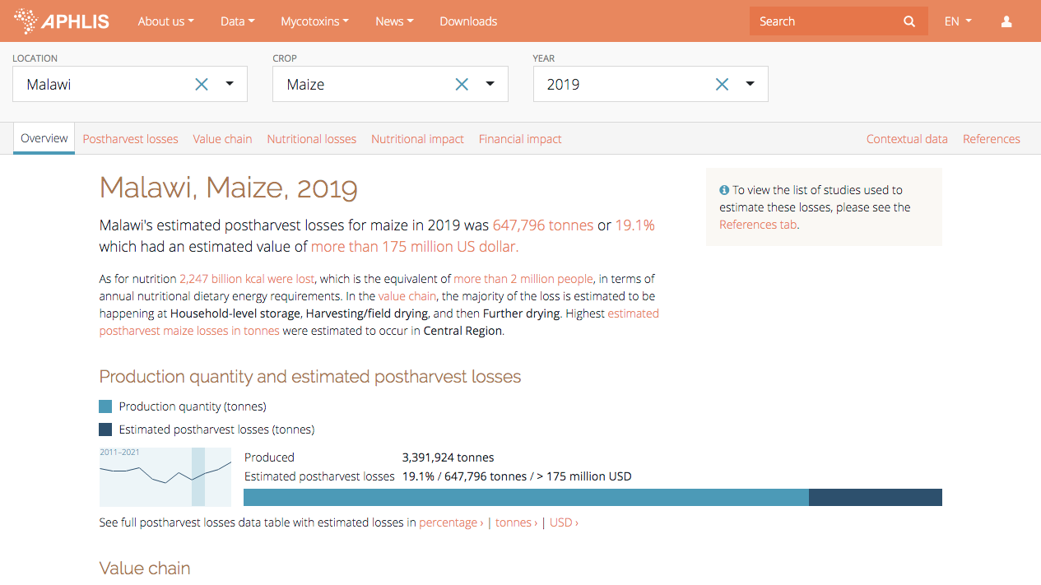
www.aphlis.net
Notes:
APHLIS provides data on:
the volume of commodity losses at different stages along the value chain;
the percentage of losses per commodity;
the nutritional implications of the losses;
the financial values of the losses, and what they represent in terms of agricultural and national GDP.
As we can see from this slide, in 2019, Malawi lost an estimated 647 796 tonnes of maize postharvest with a value of more than 175 million dollars.
All APHLIS estimates are scientifically rigorous, transparent and freely available on its website: www.aphlis.net

Slide 9
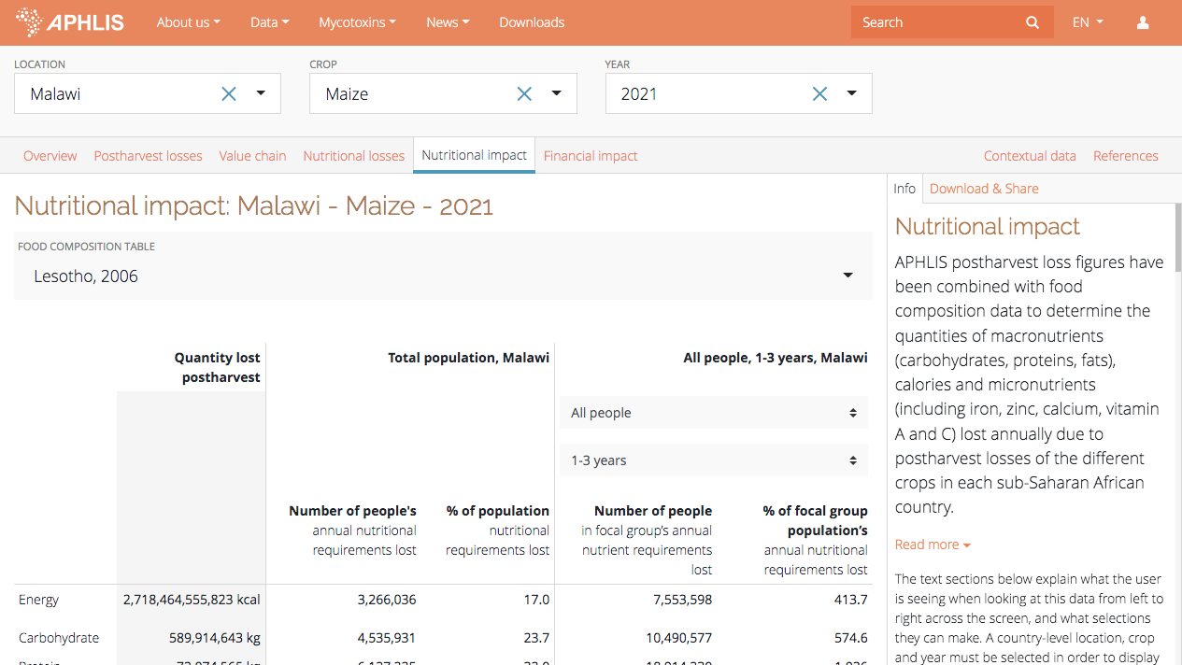
Nutritional impact
APHLIS uses food composition data to determine the quantities of nutrients lost annually during and after harvesting including:
macronutrients (carbohydrates, proteins, fats)
micronutrients (including iron, zinc, calcium, vitamins A and C)
dietary energy (kcals) of the lost food
www.aphlis.net
Notes:
An APHLIS tool allows users to calculate the nutritional impacts of postharvest losses.
Selecting a particular country and crop, users can learn how much of a given nutrient has been lost per year (starting in 2010) and how many people’s dietary needs were not met as a result.
The tool measures the loss of macronutrients (carbohydrates, proteins, fats), micronutrients (iron, zinc, calcium, vitamins A and C) and dietary energy (kcals).
The calculations consider the dietary requirements of different groups, e.g. women of childbearing age, children).
Here, for example, maize losses in Malawi in 2021 meant that more than 7.5 million children from 1 to 3 years of age did not meet their energy requirements from local maize.
Nutritional loss information is available at national and subnational levels.

Slide 10
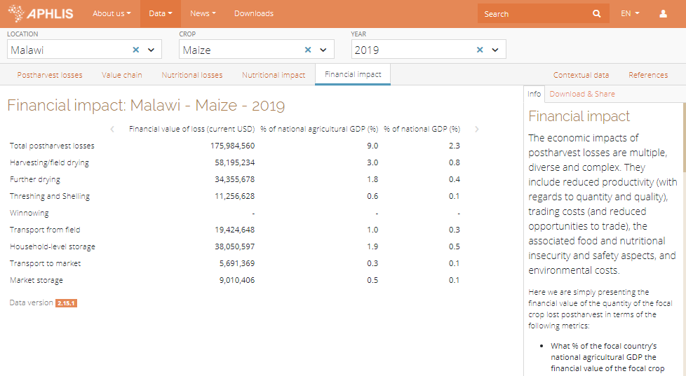
Financial impact
APHLIS determines the financial impact of postharvest loss in terms of:
monetary value of crop loss
percentage of national and agricultural GDP represented by the loss
www.aphlis.net
Notes:
Another APHLIS tool estimates the financial value of postharvest losses by multiplying the number of tonnes of a commodity lost each year during postharvest processes in a country (based on APHLIS data) by the price of that commodity.
Additional data show the financial value of postharvest losses as a percentage of national and agricultural GDP.
In Malawi, for example, maize losses in 2019 cost the country almost 176 million USD, around 9 percent of agricultural GDP.

Slide 11
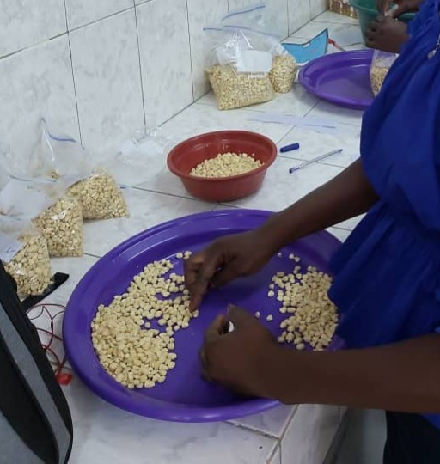
APHLIS loss estimates are:
based on rigorously-measured scientific data
transparent
based on local context (with inputs from local experts)
upgraded as more information becomes available
freely available at www.aphlis.net
www.aphlis.net
Notes:
APHLIS loss estimates are:
based on rigorously-measured scientific data;
transparent;
based on context with inputs from local experts;
adjustable year by year;
upgraded as additional high-quality information becomes available;
freely available online.
APHLIS generates information that would be prohibitively expensive to obtain through direct observation and measurement. The APHLIS model uses data provided by network members and derived from scientific literature, replacing extensive and costly loss assessment activities in the field.

Slide 12

Alignment of APHLIS with the Biennial Review
Coverage
 | Countries | Priority commodities |  | Value chain stages
CAADP BR |  | Rice Maize Sorghum Millet Legumes Cassava | Cotton Oil palm Beef Dairy Poultry Fisheries | Harvesting Storage Transportation Processing Packaging Sales
APHLIS |  | Rice Maize Sorghum Millet Legumes Cassava | Wheat Teff Oats Barley Fonio | Harvesting Primary processing (drying, threshing, shelling, winnowing, field transport) Household storage Transport Market storage
55
43
www.aphlis.net
Notes:
APHLIS has made it a major priority to help African countries measure and monitor their progress in achieving the Malabo Declaration targets on postharvest losses.
There is quite a large overlap in interests (the text in blue indicates divergences). APHLIS currently provides postharvest loss data for 43 of the 55 African Union member states. The AU’s 12 priority commodities are rice, maize, legumes, cassava, sorghum, millet, cotton, palm oil, beef, dairy, poultry and fisheries. For the purposes of BR reporting, AU member states should report on 6 priority commodities out of these 12. APHLIS works on six of the African Union’s 12 priority commodities (rice, maize, sorghum, millet, legumes and cassava).
APHLIS covers food losses at various points along the value chain: harvest, primary processing (drying, threshing, shelling, winnowing, field transport), household storage, transport, and market storage. The AU also considers food losses (and waste) during processing, packaging and sales, stages that are not covered by APHLIS.
According to the Malabo framework, food loss includes any loss due to deterioration or waste. This definition is only partly aligned with APHLIS, which does not include food waste at the retail market, restaurant or consumer stages.

Slide 13
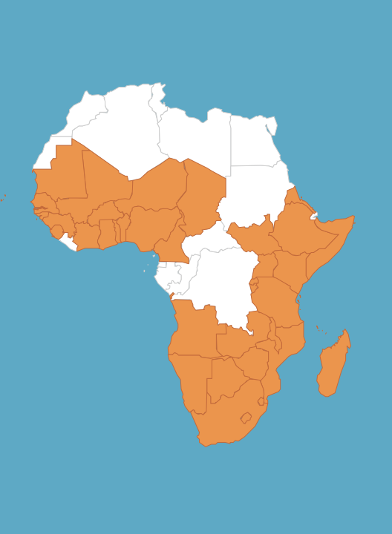
APHLIS challenges in supporting BR reporting
6 AU priority commodities are not covered by APHLIS: cotton, palm oil, beef, dairy, poultry and fisheries
The BR includes value chain activities not covered by APHLIS (processing, packaging, sales)
Many countries do not have stand-alone loss reduction strategies in place OR the strategy is not aligned with Malabo targets
Countries are unaware of what APHLIS can offer
Countries lack the capacity to use APHLIS tools
www.aphlis.net
Notes:
APHLIS faces challenges in helping countries fulfil their BR reporting requirements. As noted on the previous slide, APHLIS does not provide estimates for 6 of the 12 AU priority commodities. Nor does it measure losses that might occur during the processing, packaging and retail sales stages of the value chain.
Many countries do not yet have loss reduction policies and strategies in place (or lack the resources and/or political will to implement them). In some cases, existing strategies do not address loss data collection, which is essential for managing postharvest losses. Or they are not aligned with Malabo goals and targets, which makes BR reporting very difficult.
Additional challenges relate to the fact that many countries do not know how APHLIS can help them to meet their BR reporting requirements. They are unaware of the APHLIS tools and lack the capacity to make use of them.

Slide 14
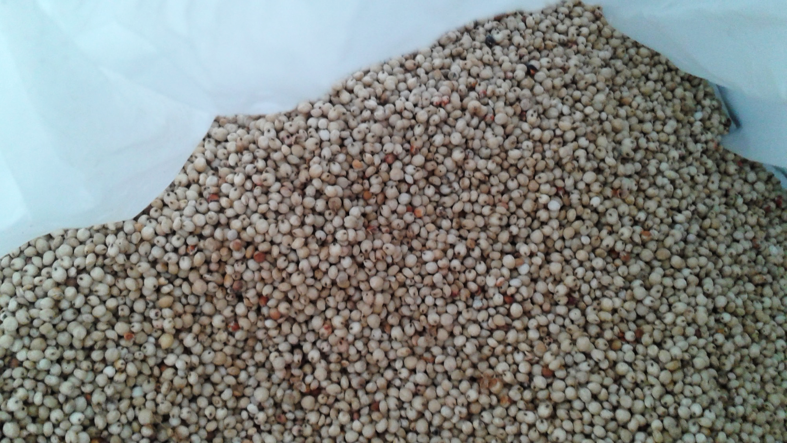
BR challenges for countries
Data
Major challenges in BR reporting relate to data:
Data collection and processing are often inadequate
Inconsistent data around units of measurement may cause data entry and calculation mistakes
Inaccurate and outdated data appear in the BR report
PHL actions
There is need for more information on the actions being taken to achieve the PHL targets
Data sources
Countries should indicate the source of PHL data used in the BR report and the methods of data estimation to ensure credibility
www.aphlis.net
Notes:
In 2021, the African Union requested that APHLIS support the third Malabo BR review by member states of the East African Community, the Southern African Development Community and the Intergovernmental Authority on Development. APHLIS was able to highlight several serious challenges that countries face in accessing and providing the data requested for the report.
The challenges include inadequate or incorrect data, the credibility of data sources and a lack of information on the actions being taken to achieve loss targets.
The African Union’s Comprehensive Africa Agriculture Development Programme (CAADP) Monitoring and Evaluation Programme has requested APHLIS’ assistance in supporting data collection and reporting. Many CAADP focal persons have asked for training on postharvest losses, the use of APHLIS and postharvest losses measurement.

Slide 15
Examples of APHLIS postharvest loss reduction activities in focal countries
Uganda
Training and awareness activities
Measuring PHL of potato and sweetpotato
Support for BR reporting on maize, rice
Rwanda
Piloting loss measurement system for cereals
Support for BR reporting on maize, rice, beans
Zambia
Developing loss measuring systems
Support for BR reporting on maize, sorghum, rice, beans
Tanzania
Developing capacity for loss measurement
Measuring PHL of legume, root and tuber crops
Support for BR reporting on maize, rice, sorghum, cassava
Zimbabwe
Support for strategy development
Measure of price discounting for cereal and legume crops due to PHL
Support for BR reporting on maize, sorghum
Malawi
Support for strategy development
Support for BR reporting on maize, groundnut
www.aphlis.net
Notes:
Another APHLIS priority – which is closely linked to the measuring and monitoring work – is to help countries develop and implement effective postharvest loss reduction policies and strategies.
APHLIS has identified six focal countries for initial support: Malawi, Rwanda, Tanzania, Uganda, Zambia and Zimbabwe. Each of these countries is updating or developing a national postharvest losses management strategy in line with the Malabo Declaration. Each has existing initiatives that complement those of APHLIS and is active in the APHLIS Network of Experts.
Malawi and Zimbabwe are being provided with financial and technical assistance for the development of their national postharvest development management strategies. In Malawi, the collaboration is with the Ministry of Agriculture, Irrigation and Water Development (MAIWD). In Zimbabwe, APHLIS is working with the Ministry of Lands, Agriculture, Water and Rural Resettlement (MLAWRR).
In Rwanda, APHLIS is working with the Rwanda Agriculture and Animal Resources Development Board (RAB) to pilot a loss measurement system developed for cereals by APHLIS.
In Tanzania, APHLIS is collaborating with the Ministry of Agriculture to develop capacity in loss measurement, including participation in a pilot to measure postharvest losses in the legume and root and tuber crops subsectors.
Zambia has an approved loss reduction strategy. Here, APHLIS is working with the Ministry of Agriculture to embed a reliable loss measuring system to enhance monitoring progress in loss reduction.
In Uganda, APHLIS is working with the Grain Council of Uganda to support training and awareness raising and with the National Agricultural Research Organization (NARO) to measure postharvest losses in root and tuber crops.

Slide 16
Examples of APHLIS postharvest loss reduction activities in other selected countries
Togo
Measurement of postharvest losses of root and tuber crops
Study of the price discounting occurring for cereal and legume crops due to postharvest losses
Nigeria
Measurement of postharvest losses in cassava systems
Benin
Measurement of postharvest losses of legume and cereal crops at farmer and trader level
www.aphlis.net
Notes:
APHLIS has also been piloting loss measurement of legume and root and tuber crops with teams in Benin, Nigeria and Togo
APHLIS supports loss monitoring and BR reporting in all focal countries for the priority commodities listed and has a network of experts in countries across the African continent

Slide 17
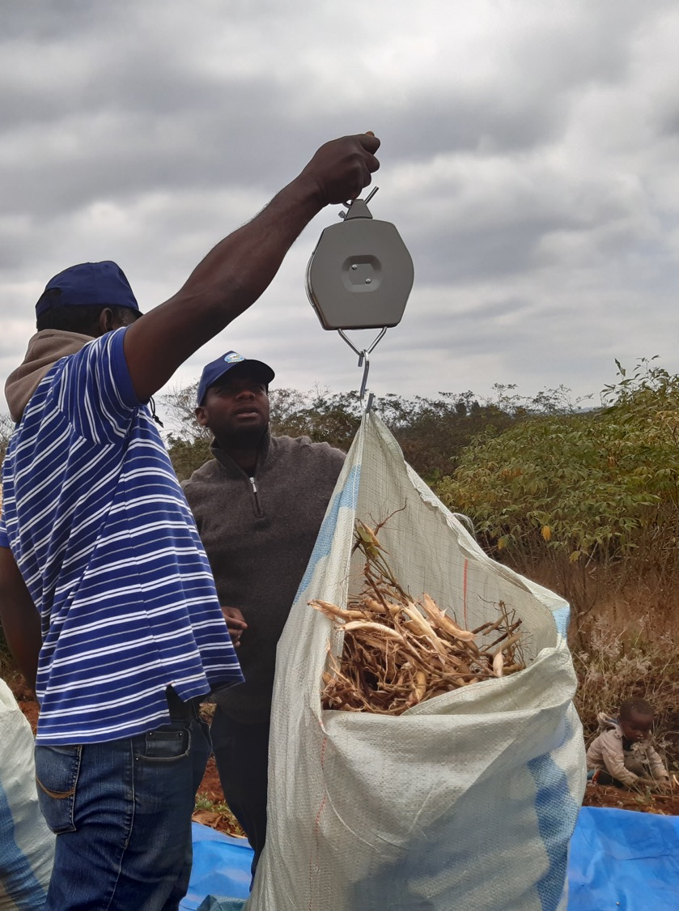
How APHLIS helps countries to achieve their Malabo commitments
APHLIS works with individual countries to help them develop postharvest loss reduction strategies
APHLIS collaborates with AU member states to improve PHL measurement and data collection for priority commodities
APHLIS continues to expand its crop coverage
APHLIS offers institutional capacity building to improve PHL management and the development of technical and policy solutions
To help countries improve their BR reporting, APHLIS provides training on using APHLIS tools and measuring postharvest losses
Notes:
As noted on previous slides, APHLIS is helping countries to meet their Malabo commitments in a number of ways:
by assisting individual countries to develop postharvest loss reduction strategies;
by assisting AU member states to improve PHL measurement and data collection for priority commodities;
by expanding its crop coverage to include a wider range of key food crops and more of the AU priority commodities;
by offering institutional capacity building to improve PHL management and the development of technical and policy solutions.
In addition, APHLIS provides training on using APHLIS tools and measuring postharvest losses. APHLIS is carrying out a series of learning labs to engage African researchers and policy-makers in innovative learning, practice and discussion around postharvest losses. The objective is to assist public sector actors to report on progress in achieving their postharvest loss reduction goals and to support the development of policies and strategies.
We also hope to encourage further use of the APHLIS platform – by practitioners, service providers, researchers, the private sector and donors – to inform investment decisions at the enterprise and farm-level.

Slide 18
Thank you!
For further information, please contact any of the following:
Cephas Taruvinga cephas.taruvinga@aphlis.net
Gideon Onumah g.e.onumah@greenwich.ac.uk
Brighton Mvumi mvumibm@hotmail.com or mvumibm@agric.uz.ac.zw
Tanya Stathers t.e.stathers@greenwich.ac.uk
info@aphlis.net

