Slide 1
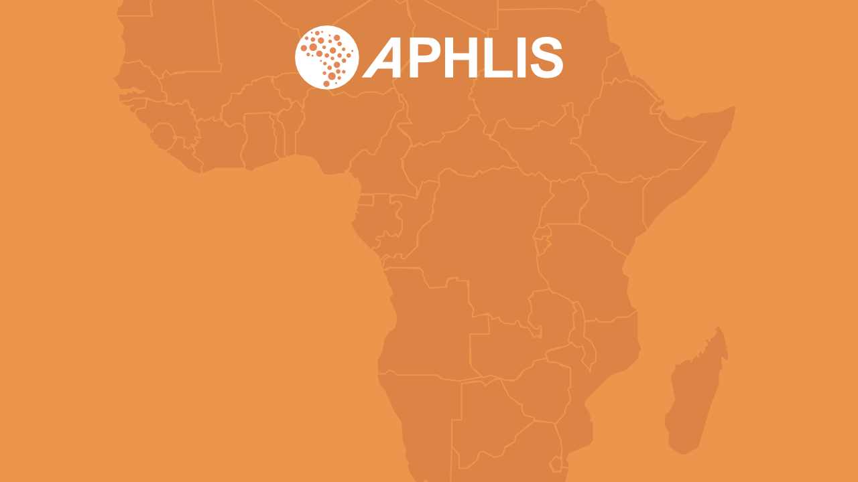
Introduction to APHLIS
The African Postharvest Losses Information System
June 2023

Slide 2








Losses can occur at any point along the postharvest value chain
Harvesting/ field drying
Transport from field
Further drying
Threshing and shelling
Winnowing
Household-level storage
Transport to market
Market storage
Birds
Wildlife
Insects
Fungi
Rain
Sprouting
Shattering
Timing
Left behind
Theft
Breakage
Spillage
Contamination
Theft
Livestock
Rain
Fungi / bacteria
Rodents
Sprouting / rotting
Soil contamination
Theft
Breakage
Spillage
Breakage
Spillage
Insects
Rodents
Fungi / bacteria
Sprouting / rotting
Contamination
Theft
Spillage
Fungi / bacteria
Poor planning
Damage
Contamination
Poor market info
Poor transport networks
Theft
Notes:
The postharvest system encompasses the stages from harvest until consumption.
Losses can occur at any of these stages. When and where they occur usually varies by crop.
Postharvest losses can result from numerous factors, including:
mechanical damage during handling;
insufficient drying;
inadequate protection during storage;
damage by birds, insects, fungi and rodents;
contamination by foreign matter or filth;
limited access of farmers to credit;
poor infrastructure;
lack of incentives to limit loss;
unforeseen developments (e.g. climate variability; new pests or diseases).
Most losses of cereal crops occur during:
storage, whether on-farm or at the market;
harvesting and field drying;
transport from field to farm.

Slide 3
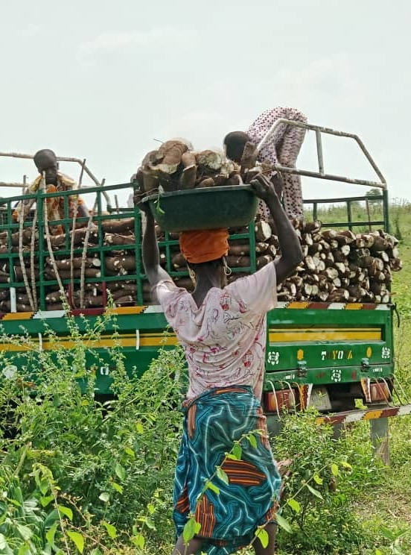
Postharvest losses in Africa
Most crop losses in sub-Saharan Africa occur before produce reaches the consumer. Up to 30-50% of crop production may be lost along the postharvest value chain. However, estimates vary widely and there is no consensus on loss figures.
www.aphlis.net
Notes:
Agriculture employs 53 percent of Africa’s labour force and accounts for about 23 percent of gross domestic product.
Most crop losses in sub-Saharan Africa (SSA) occur before produce reaches the consumer. In SSA, up to 30–50 percent of crop production may be lost along the PH value chain. The annual value of the postharvest grain lost in the region is USD 4 billion.
Loss rates differ by crop, location, etc.
Estimates vary widely and there is no consensus on loss figures.

Slide 4
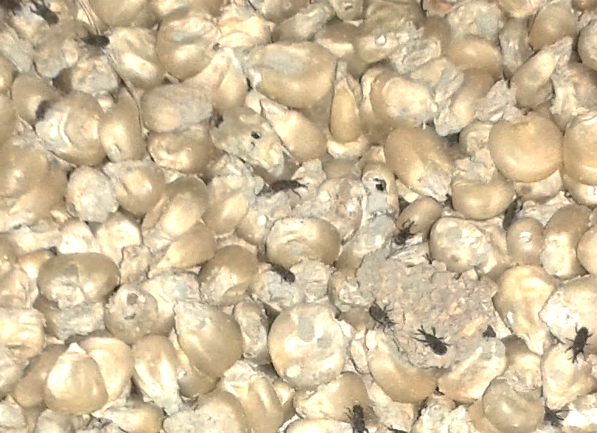
Consequences of postharvest loss (PHL)
Decreases
the amount of available food, causing food insecurity, raising prices and reducing consumer access
Reduces
food quality through the loss of caloric and nutritional value, contamination, loss of palatability or loss of consumer acceptance
Wastes
the resources used to produce the lost food: seed, fertilizer, water and human labour
Reduces
income for producers and traders at individual, local, national and global levels
Notes:
Postharvest loss:
decreases the amount of available food, causing food insecurity, raising prices and reducing consumer access;
reduces food quality through the loss of caloric and nutritional value, contamination, loss of edibility or loss of consumer acceptance;
wastes the resources used to produce the lost food (e.g. seed, fertilizer, water and human labour);
reduces income for producers, traders and consumers.

Slide 5

Societal impacts of postharvest losses
Health and nutrition
Postharvest losses cause the loss of the nutritional requirements of millions of people and can render food toxic
Economic
Postharvest losses reduce the income of farmers and countries and waste the resources used in production
Environmental
If global food loss and waste were a country, it would be the third largest greenhouse gas emitter after the USA and China
www.aphlis.net
Notes:
Health: Grains, roots and tubers are major sources of energy in the African diet. Fruits and vegetables are also critical to health and have some of the highest rates of postharvest losses. Postharvest losses can have considerable impact on human nutrition. When grains scatter or are left behind during harvesting, the nutrients they contain are lost as well. The same is true when produce falls from a cart during transport or is partially or totally damaged by pests in storage. When food is lost, its nutrients are no longer available for human consumption.
Economic: Most African farmers are smallholders, who are economically very vulnerable due to:
their high dependence on natural resources and increasingly variable climatic conditions
inconsistent, unpredictable incomes;
lack of funds to purchase inputs;
lack of training on modern farming techniques.
Environmental: Food loss and waste account for about 4.4 gigatonnes of greenhouse gas emissions each year; these include on-farm agricultural emissions and the energy used to produce, transport and store food that is ultimately lost or wasted. If food loss and waste were a country, it would be the third largest greenhouse gas emitter after the United States of America and China. At the same time, climatic factors (particularly heat and humidity) substantially increase PHL.

Slide 6
The cost of postharvest loss
Postharvest losses are estimated at around 15% for cereal crops. The annual value of postharvest cereal grain loss in sub-Saharan Africa is estimated to be up to:
USD 4 billion
out of an annual production of USD 27 billion
►
►
  That is more than the total value of food aid that the region has received over the past decade
  It is is enough to meet the annual caloric requirements of at least 48 million people
1% reduction in cereal PHL
USD 40 million annual gains for sub-Saharan Africa
Notes:
Postharvest losses are estimated at around 15 percent for cereals. The annual value of postharvest grain loss in sub-Saharan Africa is USD 4 billion of an annual production worth USD 27 billion, which:
exceeds the total value of food aid that the region has received over the past decade;
is enough to meet the annual caloric requirements of at least 48 million people.
A 1 percent reduction in postharvest losses of cereals could lead to economic gains for SSA of USD 40 million per year.

Slide 7
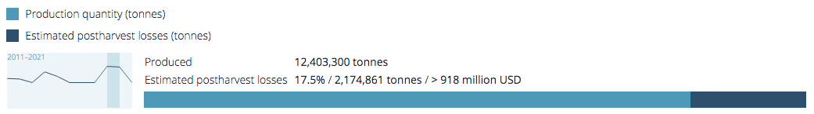
The cost of postharvest loss – Nigeria
In 2020, Nigeria lost 17.5% of its maize crop, a loss of
2,174,861 tonnes of maize. Most was lost during harvesting and household-level storage
The value of the lost grain was USD 919 million
This led to the loss of the annual iron requirements for 13 million women of child-bearing age and the protein requirements for 49 million children under five
Production quantity and estimated postharvest losses of maize in Nigeria in 2020, source aphlis.net
Notes:
In 2020, Nigeria lost 17.5 percent of its maize crop, a loss of 2,174,861 tonnes of maize. Most of the maize was lost during harvesting and household-level storage.
The value of the lost grain was USD 919 million.
This led to the loss of the annual iron requirements for 13 million women of child-bearing age and the protein requirements for 49 million children under five.

Slide 8
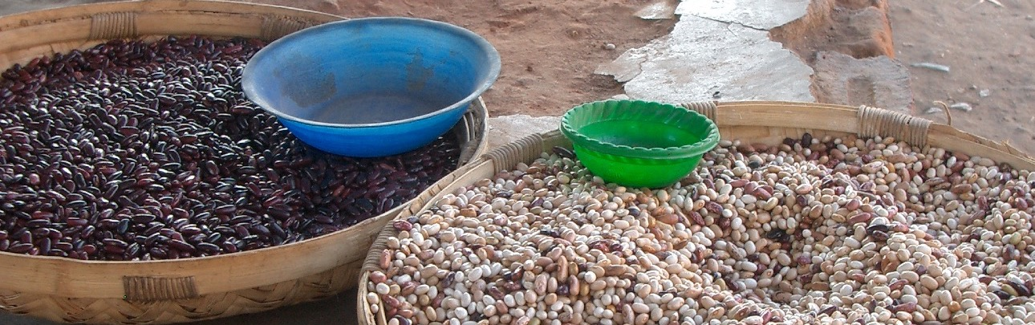
The continuing food price crisis
The international price of major cereals surged from 2006-2008, causing global unrest and pushing 50 million people into poverty
The crisis abated after 2008, however prices have remained high and unstable due to:
intermittent food shortages
low productivity
climate change
dependence on food aid
the COVID-19 pandemic
the war in Ukraine
postharvest losses
Notes:
The international price of major cereals surged from 2006-2008, pushing 50 million people into poverty.
The causes are still debated but are likely to have included drought, rising oil prices, demand for resource-intensive food and increasing costs of transport, fertilizers and other inputs.
Food prices stabilized after 2008, however they have remained high and have been unstable over the past five years due to:
intermittent food shortages;
low productivity;
difficulty adapting to climate change;
dependence on food aid;
the COVID-19 pandemic;
the war in Ukraine;
postharvest losses.

Slide 9
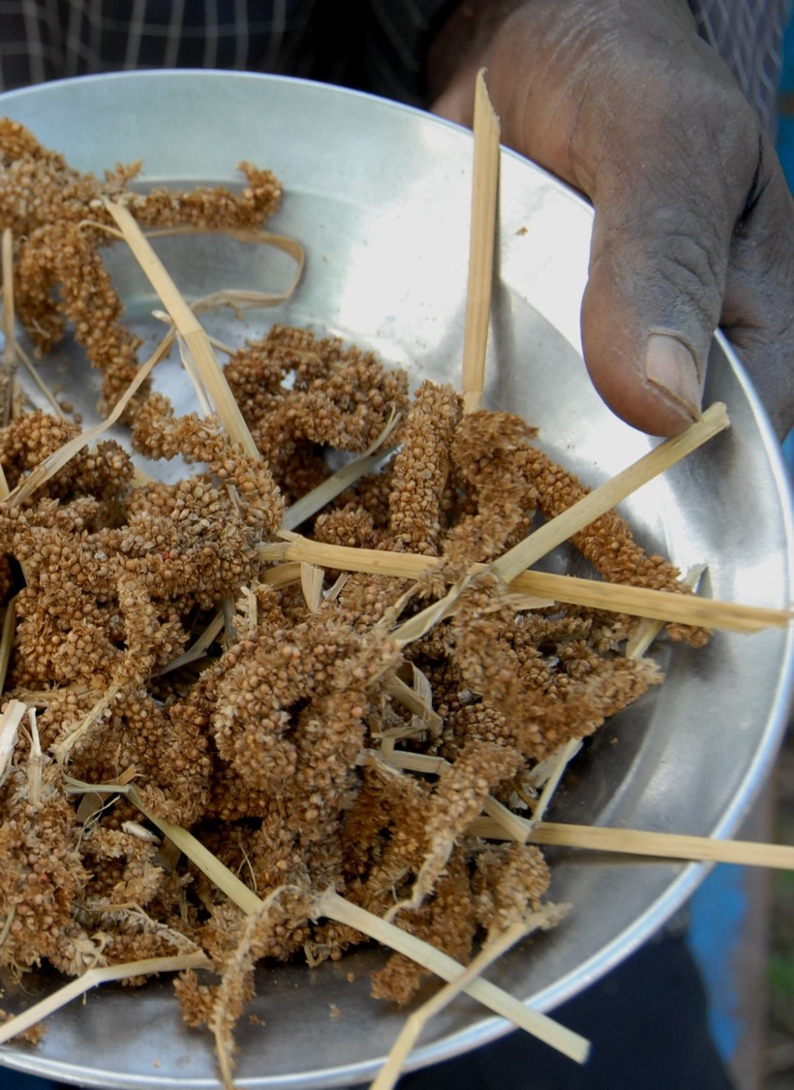
Increase needed
The future of food
The world’s population could surpass 9.7 billion by 2050 and peak at nearly 11 billion by 2100
Most population growth will occur in low-income countries
70% of Africa’s population will be urban
Food production will have to increase by 60%
80% of production increases will have to come from intensification
Food production
www.aphlis.net
Notes:
The world’s population is projected to surpass 9.7 billion by 2050 and to peak at nearly 11 billion by 2100.
Most population growth will occur in developing countries.
70 percent of Africa’s population will be urban, extending food value chains.
Food production will have to increase by 60 percent while adapting to climate change.
80 percent of the necessary production increases must come from intensification.

Slide 10
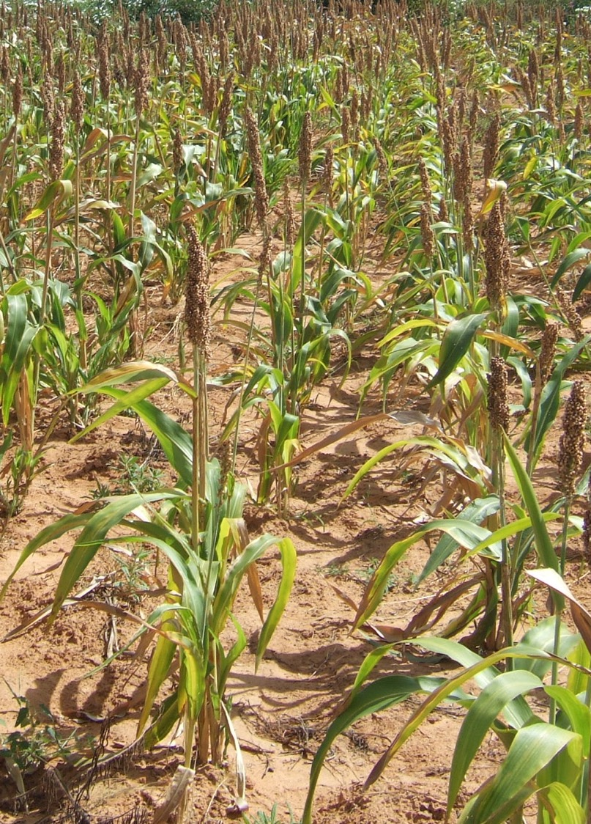
Postharvest losses and the future of food
Reducing postharvest losses can:
improve farm-level productivity
generate income
improve product quality and safety
contribute to the food and nutritional security of the rural and urban poor
increase the supply and quality of food available to consumers and potential export markets
reduce food system greenhouse gas emissions
increase the effectiveness of agricultural investments
Notes:
Loss reduction can be a more resource-efficient response to food shortages than increasing production.
Reducing postharvest loss can contribute to food security by:
improving farm-level productivity;
generating income;
improving product quality and safety;
contributing to the food and nutritional security of the rural and urban poor;
increasing the supply and quality of food available to consumers and potential export markets;
reducing greenhouse gas emissions;
increasing the cost-benefit ratio of agricultural investments.

Slide 11
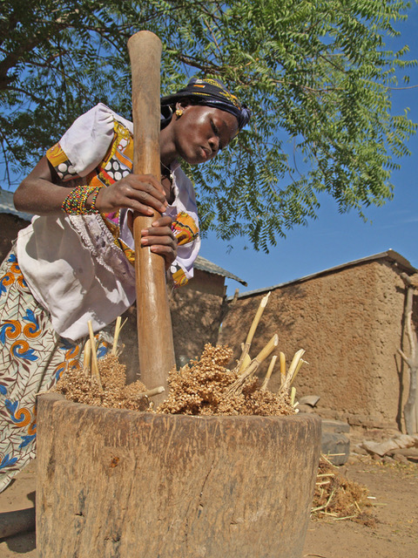
Understanding the role of women is critical
In sub-Saharan Africa, women play a vital role in postharvest activities (e.g. drying, storing, cleaning, and processing food).
Yet this role is often ignored in efforts to improve the performance of postharvest systems.
PHL policies tend to exclude women; technological solutions may not be available to them.
Photo: ICRISAT
www.aphlis.net
Notes:
In sub-Saharan Africa, women play a significant role in agriculture, particularly in postharvest activities such as drying, storing, cleaning, and processing food.
Women make decisions on how much food to store and how much to sell, based on family consumption requirements, storage facilities, market price and need for immediate cash.
Women’s prominence in agriculture can only increase in future, given the trend of increasing female-headed households across the region.
Yet their roles are often ignored in efforts to improve the performance of postharvest systems.
Key PHL-related policies make no mention of the part women might play in achieving PHL goals.
At the field level, efforts to reduce postharvest losses have tended to focus on technological solutions that women may not have the opportunity or resources to utilize. Women tend to face greater difficulties than men in accessing productive resources and markets. They may lack access to credit and the information they need to carry out their tasks effectively. Extension services are critical for diffusing new technologies and good practices, but they often do not recognize that reaching female farmers requires a clear understanding of their specific needs and roles, their time constraints and the cultural acceptability of interacting with male extension agents.

Slide 12

Key international commitments
The Malabo Declaration
In 2014, African Union Member States committed to ending hunger by 2025. To achieve this, they resolved to cut current levels of postharvest loss in half.
UN Sustainable Development Goal 12.3
“By 2030, halve per capita global food waste at the retail and consumer levels and reduce food losses along production and supply chains, including postharvest losses”
Notes:
In the 2014 Malabo Declaration, African Union Member States committed to ending hunger by 2025. To achieve this, they resolved to cut current levels of postharvest loss in half.
Sustainable Development Goal 12.3 (Ensure sustainable production and consumption patterns) is to “by 2030, halve per capita global food waste at the retail and consumer levels, and reduce food losses along production and supply chains, including postharvest losses.”
Given APHLIS’ focus on Africa, supporting the efforts of countries to meet their commitments under the Malabo Declaration is a key objective. I will return to this later in the presentation.

Slide 13
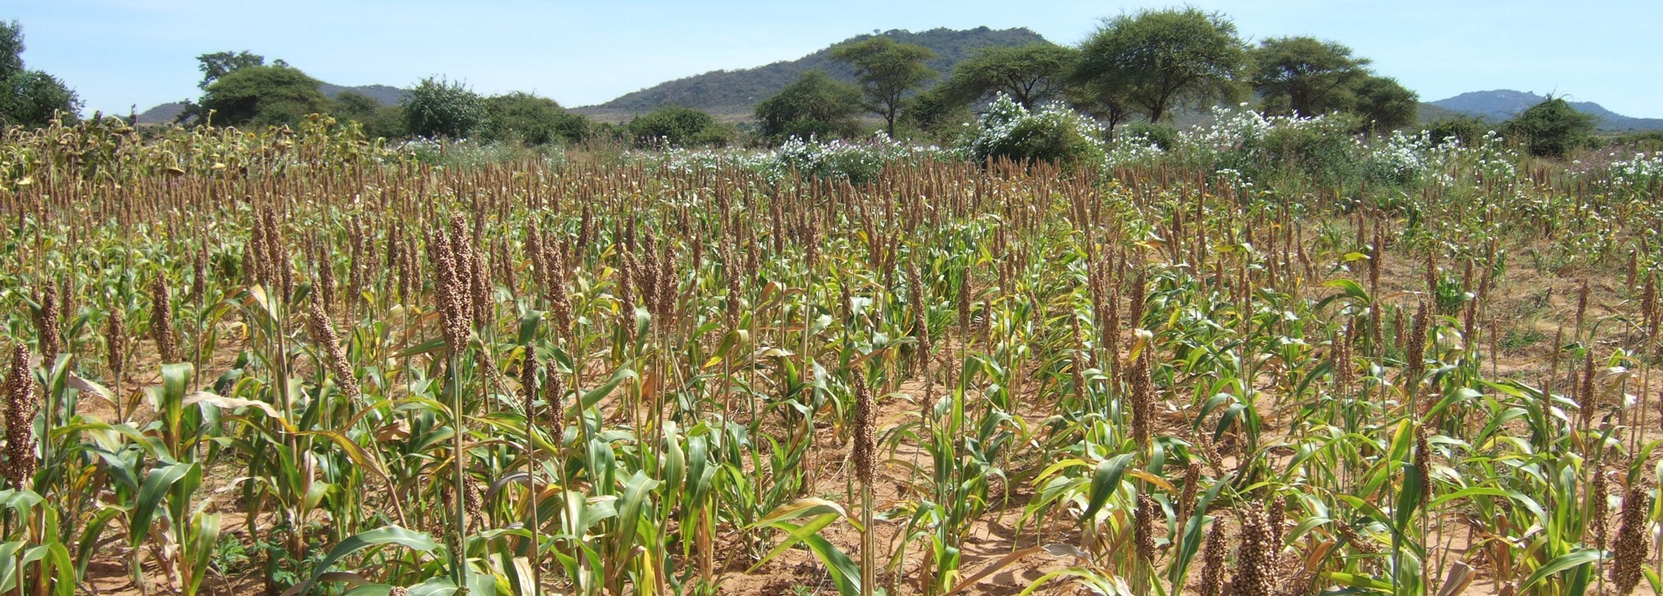
Reliable data on postharvest losses allow donors and other stakeholders to:
Better formulate agricultural policy
Monitor and evaluate loss reduction initiatives and make evidence-based loss reduction investment and policy decisions
Better estimate food supply in particular zones
Identify opportunities to strengthen value chains
Direct their interventions to the most affected geographic areas or areas where impact will be maximized
However, in many countries, reliable data on postharvest losses are scarce
Notes:
Reliable data on where, when, how and to what extent postharvest losses occur can inform investments in loss reduction programmes and agricultural and nutrition programmes in general. Such data allow donors and other stakeholders to:
support the formulation of agricultural policy;
identify opportunities to strengthen value chains;
direct their interventions to the most affected geographic areas or those where impact or efficiency will be maximized;
more reliably estimate food supply in particular zones (food supply = production – PHLs);
monitor and evaluate loss reduction initiatives.
However, in many developing countries, reliable data on postharvest losses are scarce.

Slide 14
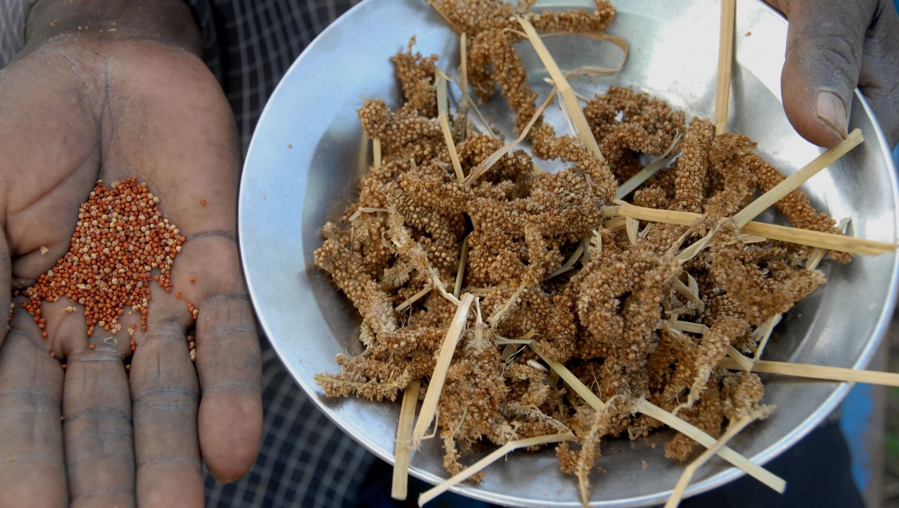
Why are reliable postharvest losses data scarce?
1
2
Data are often based on conjecture rather than on actual measurements
The logic and information sources are not always traceable
3
4
Few studies examine loss along the full value chain
Data sources are unreliable
www.aphlis.net
Notes:
Commonly available data are often based on conjecture;
The logic and information sources are not always traceable, and it is therefore difficult or impossible to judge their accuracy and trustworthiness;
Very few studies follow PHLs along the full value chain (issues of time, space, actors, cost).
Focus has been predominantly on storage losses and on cereals, particularly maize.
Timing: The loss assessment team might not be on site when the farmer decides it is time to harvest.
Data sources may not be very reliable because:
They rarely take climate conditions into account.
They may not give adequate attention to the roles played by women and young people in postharvest activities, thus missing out on valuable information.
They often assume that percentage grain damage is the same as percentage loss.
They use limited and, in some cases, inadequate sampling methodologies and therefore sometimes rely on extreme cases.
They do not indicate time scale or consumption/sales patterns in relation to storage losses.
They often rely on people’s perceptions, which can be biased voluntarily or involuntarily.
As a result, it is difficult to assess the impact that postharvest losses have on smallholder productivity and welfare.

Slide 15
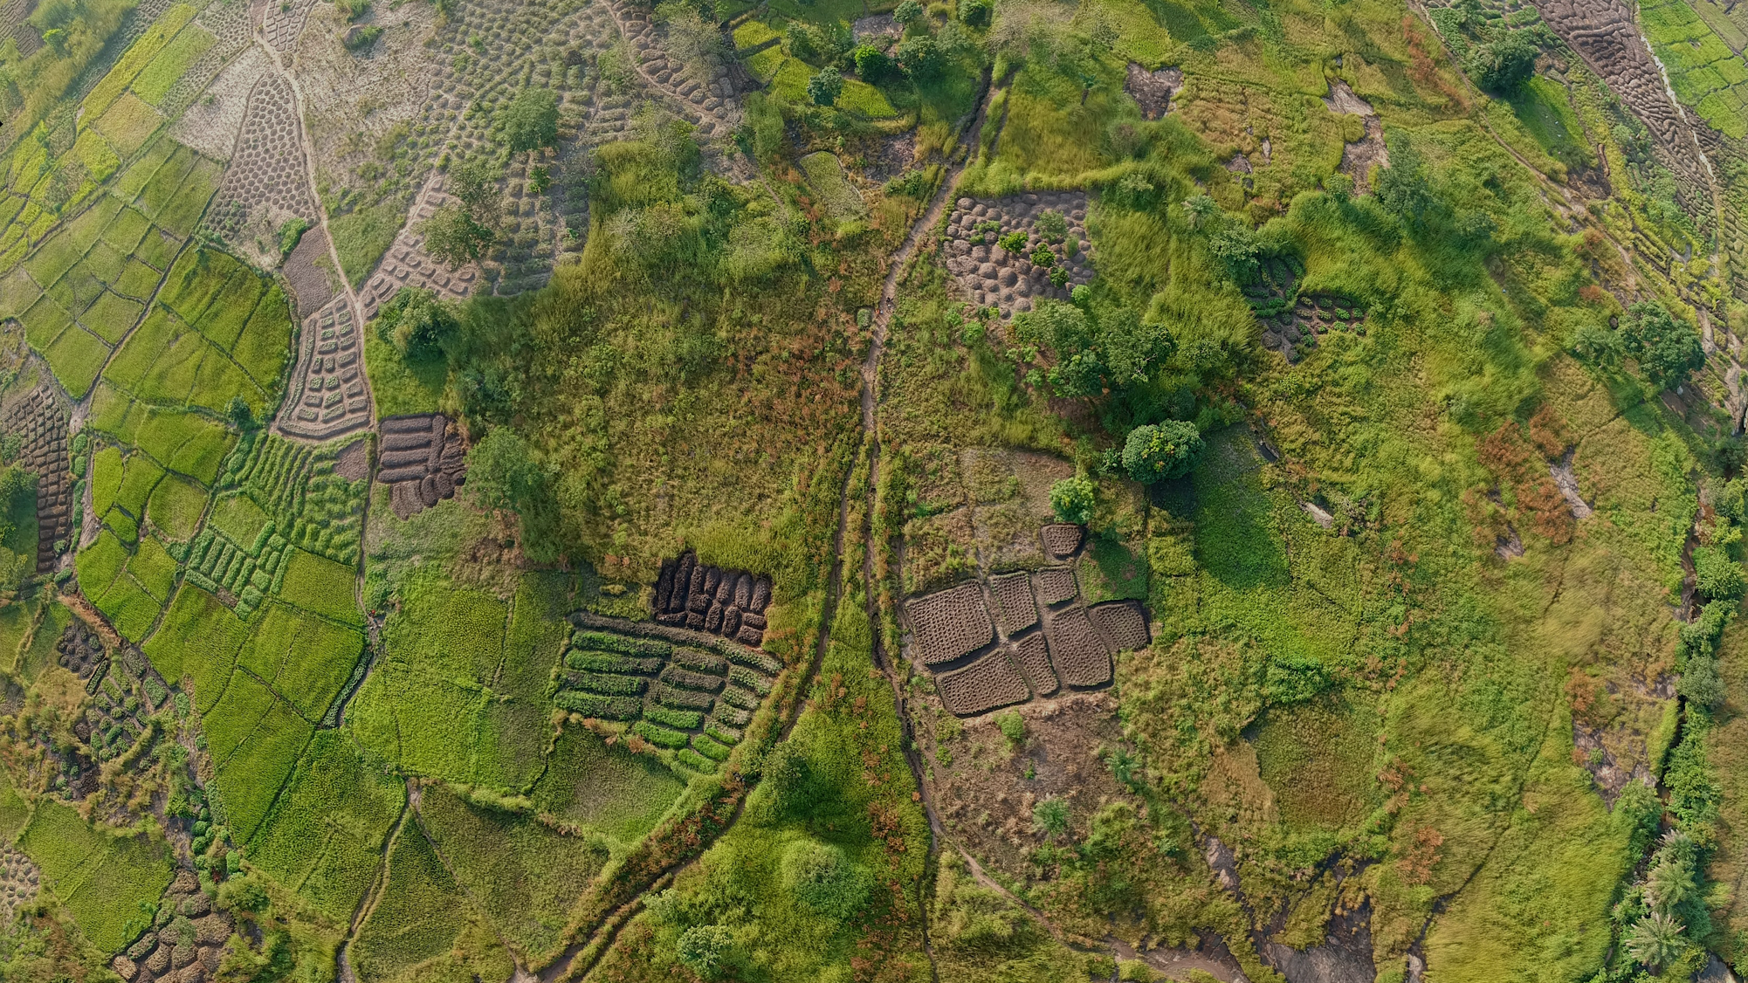
The African Postharvest Losses Information System (APHLIS) is the foremost international effort to collect, analyse and disseminate data on postharvest losses of cereal grains, legumes, roots and tubers in sub-Saharan Africa
Notes:
The African Postharvest Losses Information System (APHLIS) is the foremost international effort to collect, analyze and disseminate data on postharvest losses in sub-Saharan Africa.
Backed by expertise in agricultural research, value chain development, postharvest management, commodity quality analysis, and policy development, APHLIS generates information on the postharvest losses of cereal grains, legumes, roots and tubers.
APHLIS was established in 2009 by the European Commission’s Joint Research Centre. A second phase, known as APHLIS+, got underway in 2016. APHLIS+ is expanding the range of crops covered and includes estimates of the financial and nutritional dimensions of postharvest loss. APHLIS+ is also improving the online, interactive tools for accessing loss data and expanding the African PHL expert network.

Slide 16
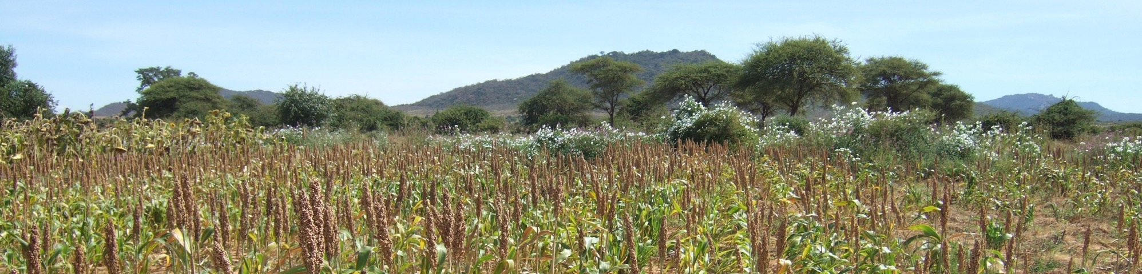
APHLIS objectives
Support
the development of national postharvest loss reduction strategies
Help
countries meet their postharvest loss commitments.
Supply
decision-makers with the data they need to determine where and how to focus loss reduction efforts
Improve
the efficiency of value chains and support food security planning
Provide
the basis for monitoring and evaluating loss reduction programmes
Notes:
to support the development of national postharvest losses strategies;
to help countries meet their postharvest loss reduction commitments;
to provide decision-makers with the data they need to determine where and how to focus loss reduction efforts;
to improve the efficiency of value chains and support food security planning;
to provide the basis for monitoring and evaluating loss reduction programmes.

Slide 17

APHLIS extracts PHL data from scientific literature to produce loss estimates at each stage of the postharvest value chain
↓
How APHLIS works →
www.aphlis.net
← To refine the loss estimates, national experts and statistics officers provide context-specific information on:
Subnational production data
Prevalent
pests
Weather conditions
Storage
duration
Percentage marketed
Common PHL loss reduction practices
Notes:
APHLIS calculates postharvest loss estimates per crop and province on an annual basis, supporting countries in developing postharvest loss reduction strategies and helping them to track changes in their loss levels over time as required in Malabo reporting. APHLIS supplies policymakers with the data they need to determine where to focus loss reduction strategies and to improve value chain efficiency and food security. Using a downloadable APHLIS calculator, countries can include further data to fine-tune their loss estimates or to develop or compare loss reduction scenarios. This can assist policymakers in planning, monitoring and evaluating the effectiveness of their initiatives to reduce postharvest losses.
APHLIS bases its loss estimates on two sources of information:
loss data derived from scientific literature, broken down by crop, type of farm and climate; and
local factors, e.g. conditions and practices that can affect losses (production, pests, weather, storage conditions and duration, marketing, loss reduction practices, etc.).
Together, this information enables APHLIS to estimate postharvest losses at the provincial, national and regional levels.
All APHLIS estimates are scientifically rigorous, transparent and freely available on its website: www.aphlis.net

Slide 18
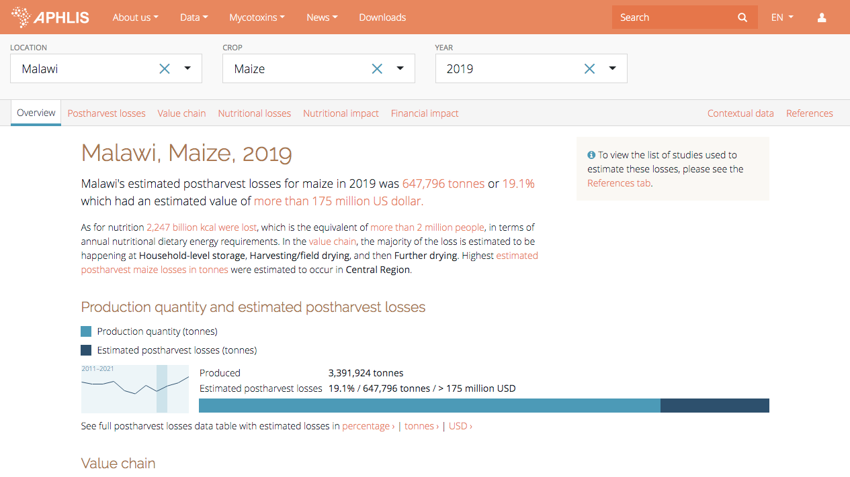
Notes:
APHLIS provides data on:
the volume of commodity losses at different stages along the value chain;
the percentage of losses per commodity;
the nutritional implications of the losses;
the financial values of the losses, and what they represent in terms of agricultural and national GDP.
As we can see from this slide, in 2019, Malawi lost an estimated 647, 796 tonnes of maize postharvest with a value of more than 175 million dollars.

Slide 19
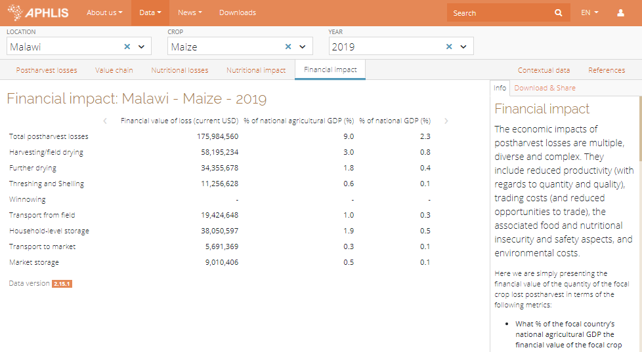
Financial impact
APHLIS determines the financial impact of postharvest loss in terms of:
monetary value of crop loss
percentage of national and agricultural GDP represented by the loss
www.aphlis.net
Notes:
An APHLIS tool estimates the financial value of postharvest losses by multiplying the number of tonnes of a commodity lost each year during postharvest processes in a country (based on APHLIS data) by the price of that commodity.
Additional data show the financial value of postharvest losses as a percentage of national and agricultural GDP.
In Malawi, for example, maize losses in 2019 cost the country almost 176 million USD, around 9 percent of agricultural GDP.

Slide 20
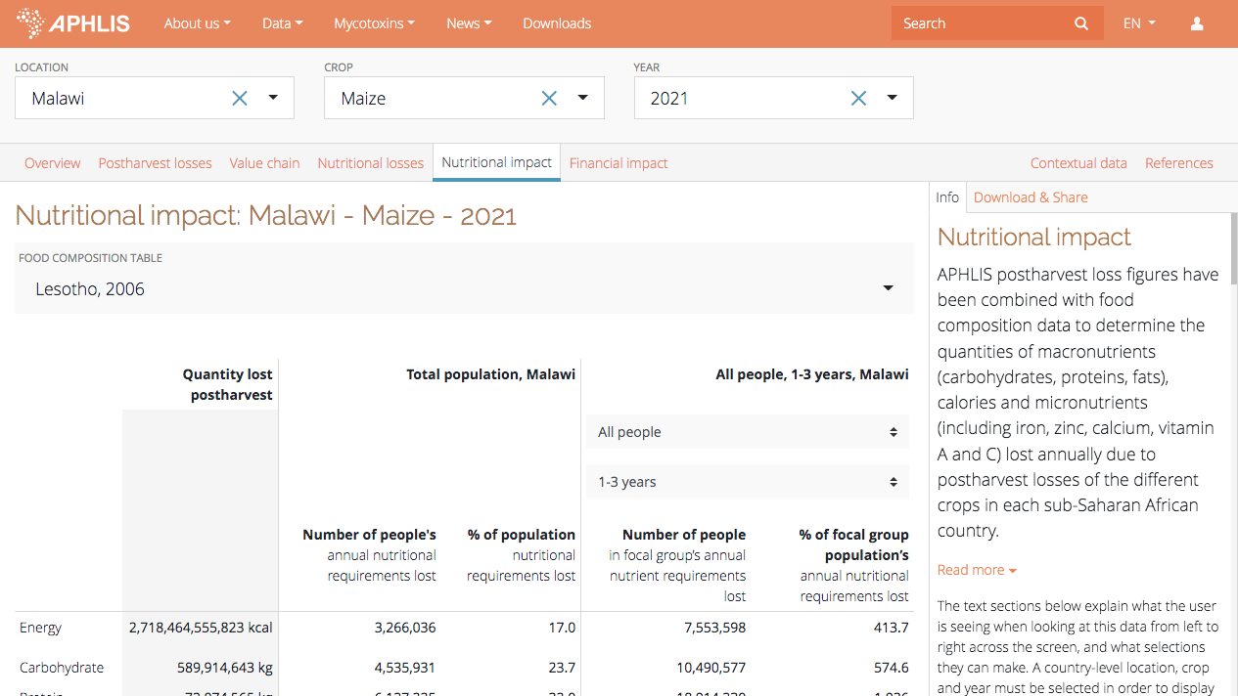
Nutritional impact
APHLIS uses food composition data to determine the quantities of nutrients lost annually during and after harvesting including:
macronutrients (carbohydrates, proteins, fats)
micronutrients (including iron, zinc, calcium, vitamins A and C)
dietary energy (kcals) of the lost food
www.aphlis.net
Notes:
Another APHLIS tool allows users to calculate the nutritional impacts of postharvest losses.
Selecting a particular country and crop, users can learn how much of a given nutrient has been lost per year (starting in 2010) and how many people’s dietary needs were not met as a result.
The tool measures the loss of macronutrients (carbohydrates, proteins, fats), micronutrients (iron, zinc, calcium, vitamins A and C) and dietary energy (kcals).
The calculations consider the dietary requirements of different groups, e.g. women of childbearing age, young children).
Here, for example, maize losses in Malawi in 2021 meant that more than 7.5 million children from 1 to 3 years of age did not meet their energy requirements from local maize.
Nutritional loss information is available at national and subnational levels.

Slide 21
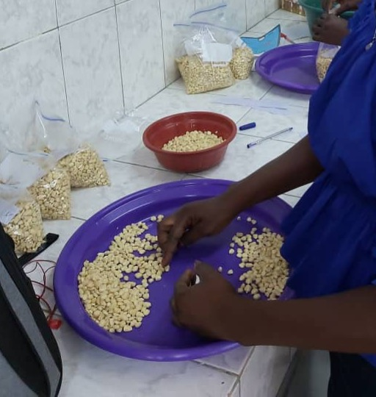
APHLIS loss estimates are:
based on rigorously-measured scientific data
transparent
based on local context (with inputs from local experts)
upgraded as more information becomes available
cost-effective
freely available at www.aphlis.net
www.aphlis.net
Notes:
APHLIS loss estimates are:
based on rigorously-measured scientific data;
transparent;
based on context with inputs from local experts;
adjustable year by year;
upgraded as additional high-quality information becomes available;
freely available online;
APHLIS generates information that would be prohibitively expensive to obtain through direct observation and measurement. The APHLIS model uses data provided by network members and derived from scientific literature, replacing extensive and costly loss assessment activities in the field.

Slide 22
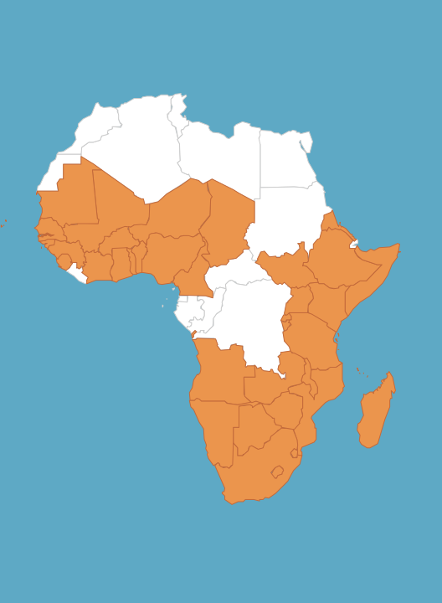
The APHLIS Network
The APHLIS Network comprises postharvest loss experts from sub-Saharan African countries, who:
provide contextual information to increase the accuracy of estimates
provide seasonal crop production data
submit country narratives to deepen knowledge about national postharvest systems
provide technical and advisory support for national efforts around Malabo implementation
act as ambassadors for APHLIS
Notes:
The APHLIS network currently includes postharvest loss experts from 40 African countries and is constantly working to expand its coverage.
Network members:
provide context-based information to increase the accuracy of estimates (e.g. damp weather at harvest, percentage of crop retained on farm for storage, length of storage period, number of harvests);
provide seasonal crop production data;
submit country narratives to provide detail on their PH systems;
support national efforts around Malabo implementation;
act as APHLIS ‘ambassadors.’

Slide 23
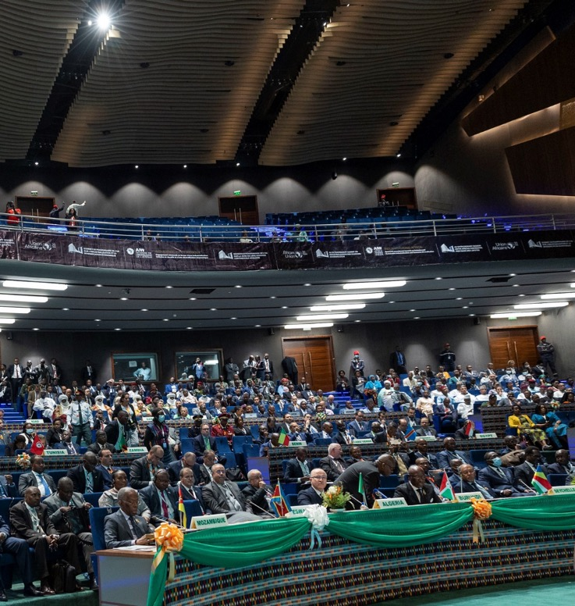
The Malabo Declaration
In June 2014, the African Union Assembly adopted the Malabo Declaration on Accelerated Agricultural Growth
A target to reduce postharvest losses by half is included under the commitment to end hunger in Africa by 2025
It aims to limit degradation in quantity and in quality of food at all stages of the food chain (harvest, storage, transport, processing, retail market)
Photo: Extraordinary Summit of the African Union by Paul Kagame
www.aphlis.net
Notes:
The Comprehensive Africa Agriculture Development Programme (CAADP) is Africa’s policy framework for agricultural transformation, food security and nutrition, economic growth, and prosperity.
To mark CAADP’s tenth anniversary in 2014, the African Union (AU) Heads of State and Government declared the Year of Agriculture and Food Security, a chance to consider achievements and lessons learned over CAADP’s first decade.
This led to the adoption of the Malabo Declaration on Accelerated Agricultural Growth and Transformation for Shared Prosperity and Improved Livelihoods by the AU Assembly in June 2014.
The declaration includes a major commitment to end hunger in Africa by 2025.
Among other targets, signatory countries pledged to halve 2015 levels of postharvest losses by 2025. The aim was to limit degradation in quantity and quality of produced food at all stages of the food production chain (harvest, storage, transport, processing, retail market).
The AU Commission requires member states to report on progress made in reducing postharvest losses, as part of their biennial reporting on the Malabo commitments.
Member States are also expected to develop postharvest loss reduction strategies that are consistent with their Malabo Declaration postharvest losses reduction goals.

Slide 24
Country challenges
According to the AU Commission, a number of challenges limit the ability of countries to meet their Malabo commitments:
Limited awareness about PHL
Lack of PHL policies and strategies
Limited capacity in PH management
Inadequate PHL research and development
Lack of knowledge about how to measure PH losses
Inadequate storage technologies
Lack of appreciation of impact of PHL
Lack of adequate financing for PHL reduction actions
Notes:
In a 2018 report, the African Union Commission identified a number of challenges that limit the ability of countries to meet their Malabo commitments on postharvest losses, including the lack of:
awareness about postharvest losses, including causes, impacts and solutions;
a lack of postharvest loss reduction policies and strategies at the national level;
institutional capacity in postharvest loss management;
research and development on postharvest losses;
knowledge about postharvest loss measurement methodologies;
postharvest storage technologies that limit losses;
appreciation of the economic value of postharvest losses and their impact on nutrition and food security; and
targeted financing and investment in postharvest loss reduction activities.

Slide 25
Biennial Review reporting
20
Member States reported data on losses in 2022
11
Member States met the 2020 milestone to reduce losses by 25%
The postharvest component of the CAADP Biennial Review (BR) Report monitors progress made by the 55 AU Member States in achieving Malabo Commitment 3: reduction of post-harvest losses by 50% by the year 2025
Notes:
The Biennial Review (or BR) process includes self-reported data from the AU’s 55 members – beginning in 2017 – to capture progress on agricultural transformation.
The 3rd CAADP BR was issued in 2022. Of the 20 Member States that reported data on postharvest losses of priority commodities, only 11 were on-track to meet the 2020 milestone to reduce postharvest losses by at least 25 percent.
The report recommended that Member States build capacity, not only to reduce postharvest losses, but also to reliably estimate and report losses at different points in the postharvest phase.

Slide 26
Reporting challenges
Major challenges in BR reporting relate to data:
Data collection and processing are often inadequate
Inconsistent data around units of measurement may cause data entry and calculation mistakes
Inaccurate and outdated data appear in the BR Report
There is need for more information on the actions being taken to achieve the PHL targets
The source of PHL data used in the BR Report and the methods of data estimation are needed to ensure credibility
Notes:
In 2021, the African Union requested that APHLIS support Member States of the East African Community, the Southern African Development Community and the Intergovernmental Authority on Development to carry out the third Malabo BR review. APHLIS was able to highlight several serious challenges that countries face in accessing and providing the data requested for the report.
The challenges included inadequate or incorrect data, the credibility of data sources and a lack of information on the actions being taken to achieve loss targets.
The African Union’s Comprehensive Africa Agriculture Development Programme (CAADP)’s Monitoring and Evaluation Programme has requested APHLIS’ assistance in supporting data collection and reporting. Many CAADP focal persons have asked for training on postharvest losses, the use of APHLIS and postharvest loss measurement.

Slide 27
APHLIS and BR reporting
APHLIS provides PHL data for 43 of the 55 AU member states
APHLIS covers 6 of the 12 AU priority commodities
Both APHLIS and the AU measure losses during harvest, transport and storage
BUT
6 AU priority commodities are not covered by APHLIS: cotton, palm oil, beef, dairy, poultry and fisheries
The BR includes value chain activities not covered by APHLIS (processing, packaging, sales)
Notes:
APHLIS has made it a major priority to help African countries measure and monitor their progress in achieving the Malabo Declaration targets on postharvest losses.
There is quite a large overlap in interest. APHLIS currently provides postharvest loss data for 43 of the 55 African Union member states. The AU’s 12 priority commodities are rice, maize, legumes, cassava, sorghum, millet, cotton, palm oil, beef, dairy, poultry and fisheries. For the purposes of BR reporting, AU member states should report on 6 priority commodities out of these 12. APHLIS works on six of the African Union’s 12 priority commodities (rice, maize, sorghum, millet, legumes and cassava).
APHLIS covers food losses at various points along the value chain: harvest, primary processing (drying, threshing, shelling, winnowing, field transport), household storage, transport, and market storage. The AU also considers food losses (and waste) during processing, packaging and sales, stages that are not covered by APHLIS.
According to the Malabo framework, food loss includes any loss due to deterioration or waste. This definition is only partly aligned with APHLIS, which does not include food waste at the retail market, restaurant or consumer stages.

Slide 28
APHLIS actions in support of Malabo commitments
Engagement with policymakers, especially in the ministries of agriculture, to raise awareness of BR-relevant reporting metrics and the role of APHLIS
Technical support for national postharvest loss reduction strategies aligned with Malabo commitments
Institutional capacity building
Notes:
APHLIS is helping countries to meet their Malabo commitments in several ways:
by helping individual countries develop postharvest loss reduction strategies;
by assisting AU member states to improve PHL measurement and data collection for priority commodities;
by expanding its crop coverage to include a wider range of key food crops and more of the AU priority commodities;
by offering institutional capacity building to improve PHL management and the development of technical and policy solutions.
In addition, APHLIS provides training on using APHLIS tools and measuring postharvest losses. APHLIS is carrying out a series of learning labs to engage African researchers and policy-makers in innovative learning, practice and discussion around postharvest losses. The learning labs take place online, with the support of APHLIS experts. Participants work together to extract APHLIS data to formulate advice on postharvest loss mitigation activities and policies. The objective is to assist public sector actors to report on progress in achieving their postharvest loss reduction goals and to support the development of policies and strategies. We also hope to encourage further use of the APHLIS platform – by practitioners, service providers, researchers, the private sector and donors – to inform investment decisions at the enterprise and farm-level.

Slide 29
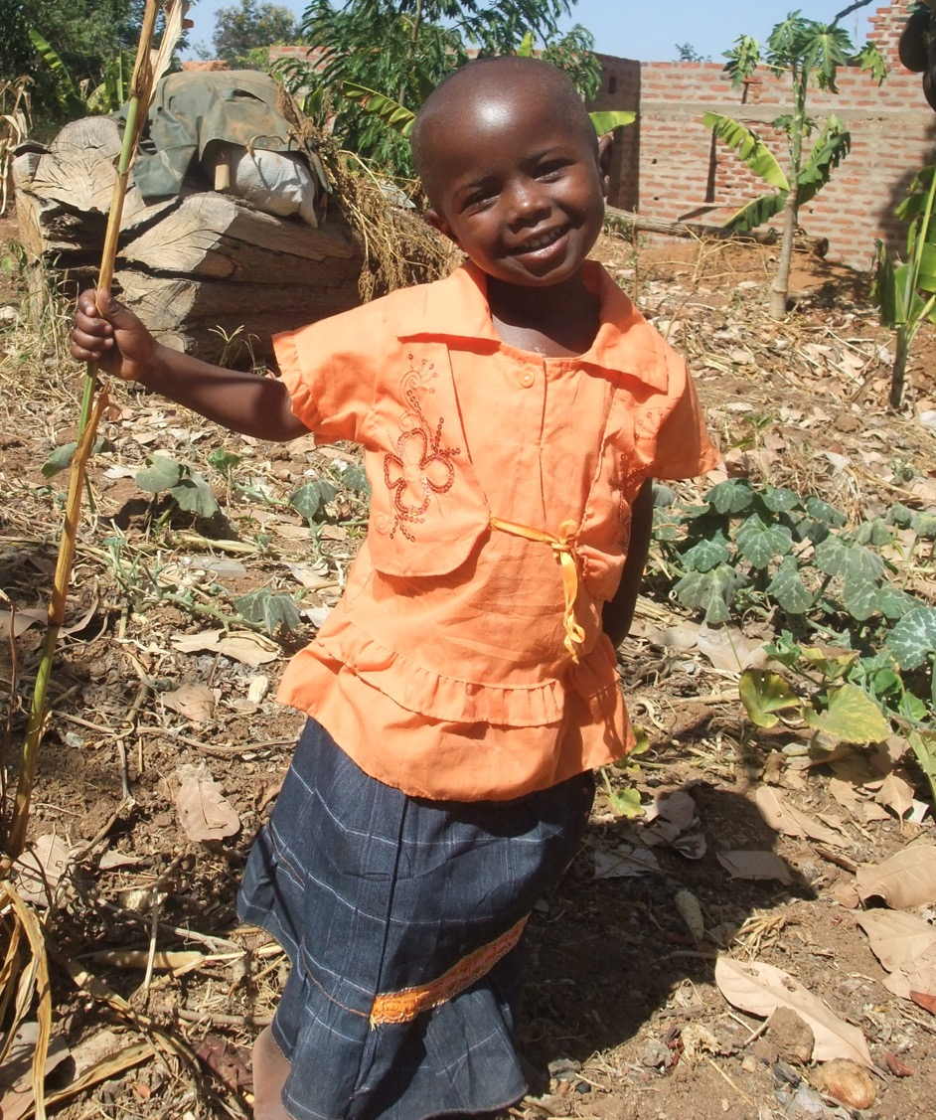
What’s ahead for APHLIS
An expanded scope that includes additional crops and countries
Continued recognition of APHLIS as the key source of reliable PHL estimate information for supporting decisions and reporting by governments and the private sector
Analysis of trends to support agricultural policy formulation and loss reduction activities
An active community of practice that fosters a flow of information between PHL stakeholders
Notes:
Continued efforts to ensure an accessible and user-friendly information system;
The inclusion of additional crops and countries;
Analysis of trends to support agricultural policy formulation and loss reduction activities;
Global recognition of APHLIS as the key source of reliable PHL estimate information for supporting and influencing decisions by governments and the private sector.
Support for an active community of practice that fosters a flow of information between PHL stakeholders.

Slide 30
Thank you!
For further information, please contact any of the following:
info@aphlis.net
Cephas Taruvinga cephas.taruvinga@aphlis.net
Gideon Onumah g.e.onumah@greenwich.ac.uk
Brighton Mvumi mvumibm@hotmail.com or mvumibm@agric.uz.ac.zw
Tanya Stathers t.e.stathers@greenwich.ac.uk

