Slide 1
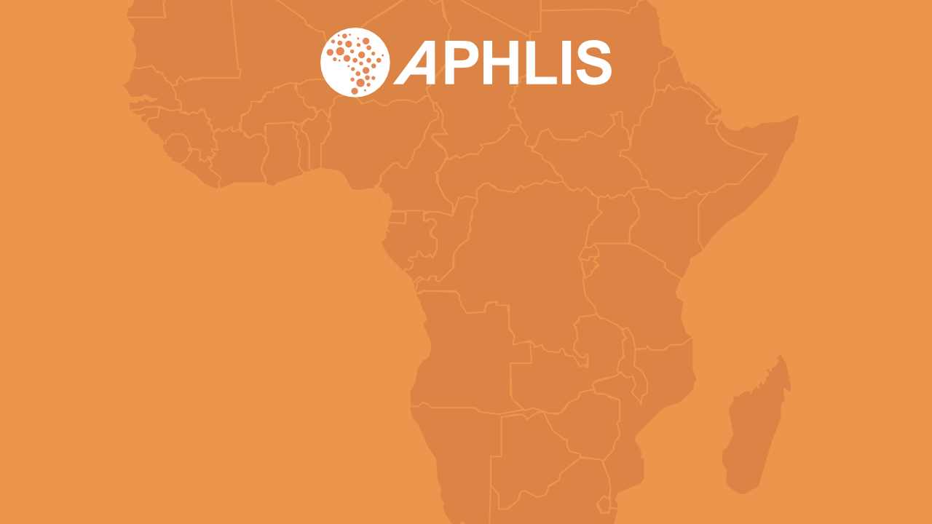
Introduction to APHLIS
The African Postharvest Losses Information System
June 2023

Slide 2








Losses can occur at every point along the postharvest value chain
Harvesting / field drying
Transport from field
Further drying
Threshing and shelling
Winnowing
Household-level storage
Transport to market
Market storage
Birds
Wildlife
Insects
Fungi
Rain
Sprouting
Shattering
Timing
Left behind
Theft
Breakage
Spillage
Contamination
Theft
Livestock
Rain
Fungi / bacteria
Rodents
Sprouting / rotting
Soil contamination
Theft
Breakage
Spillage
Breakage
Spillage
Insects
Rodents
Fungi / bacteria
Sprouting / rotting
Contamination
Theft
Spillage
Fungi / bacteria
Poor planning
Damage
Contamination
Poor market info
Poor transport networks
Theft
Notes:
The postharvest system encompasses the stages from harvest until consumption.
Losses can occur at any of these stages. When and where they occur usually varies by crop.
Postharvest losses can result from numerous factors, including:
mechanical damage during handling;
insufficient drying;
inadequate protection during storage;
damage by birds, insects, fungi and rodents;
contamination by foreign matter or filth;
limited access of farmers to credit;
poor infrastructure;
lack of incentives to limit loss;
unforeseen developments (e.g. climate variability; new pests or diseases).
Most losses of cereal crops occur during:
storage, whether on-farm or at the market;
harvesting and field drying;
transport from field to farm.

Slide 3
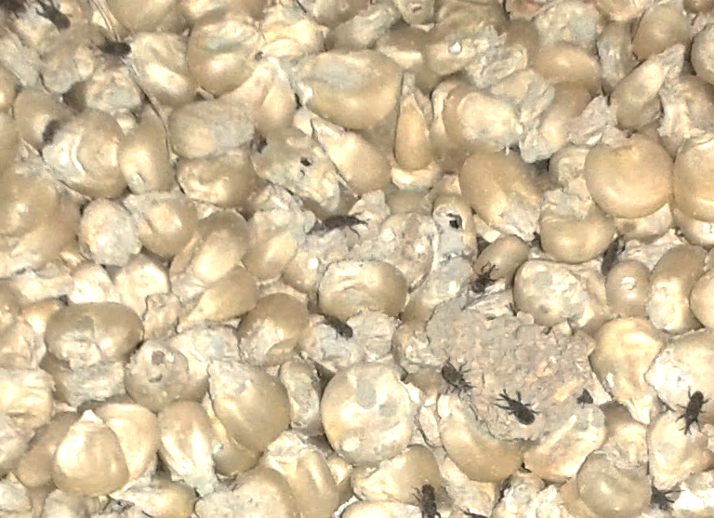
Consequences of postharvest loss (PHL)
Decreases
the amount of available food, raising prices and reducing consumer access
Reduces
food quality through the loss of caloric and nutritional value, contamination, loss of palatability or loss of consumer acceptance.
Wastes
the resources used to produce the lost food: seed, fertilizer, water and human labour
Reduces
income for producers and traders at individual, local, national and global levels
Notes:
Postharvest loss:
decreases the amount of available food, causing food insecurity, raising prices and reducing consumer access;
reduces food quality through the loss of caloric and nutritional value, contamination, loss of edibility or loss of consumer acceptance;
wastes the resources used to produce the lost food (e.g. seed, fertilizer, water and human labour);
reduces income for producers, traders and consumers.

Slide 4
The cost of postharvest loss
Postharvest losses are estimated at around 15% for cereal crops. The annual value of postharvest cereal grain loss in sub-Saharan Africa is estimated to be up to:
USD 4 billion
out of an annual production of USD 27 billion
►
►
  That is more than the total value of food aid that the region has received over the past decade
  It is enough to meet the annual caloric requirements of at least 48 million people
1% reduction in PHL
USD 40 million annual gains for sub-Saharan Africa
Notes:
Postharvest losses are estimated at around 15 percent for cereals. The annual value of postharvest grain loss in sub-Saharan Africa is USD 4 billion of an annual production worth USD 27 billion, which:
exceeds the total value of food aid that the region has received over the past decade;
is enough to meet the annual caloric requirements of at least 48 million people.
A 1 percent reduction in postharvest losses of cereals could lead to economic gains for SSA of USD 40 million per year.

Slide 5
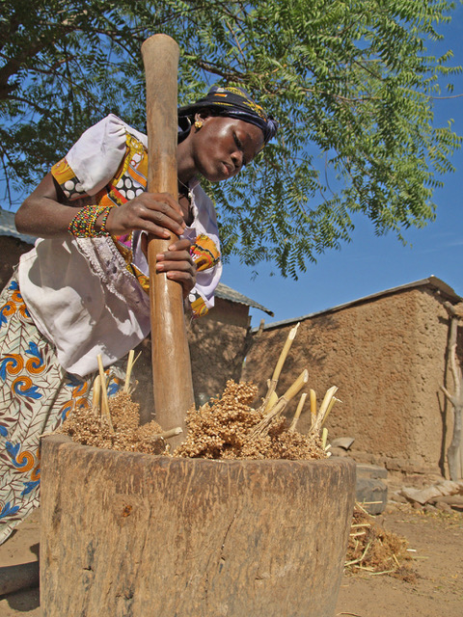
Understanding the role of women is critical
In sub-Saharan Africa, women play a vital role in postharvest activities (e.g. drying, storing, cleaning, and processing food).
Yet this role is often ignored in efforts to improve the performance of postharvest systems.
PHL policies tend to exclude women; technological solutions may not be available to them.
Photo: ICRISAT
www.aphlis.net
Notes:
In sub-Saharan Africa, women play a significant role in agriculture, particularly in postharvest activities such as drying, storing, cleaning, and processing food.
Women make decisions on how much food to store and how much to sell, based on family consumption requirements, storage facilities, market price and need for immediate cash.
Women’s prominence in agriculture can only increase in future, given the trend of increasing female-headed households across the region.
Yet their roles are often ignored in efforts to improve the performance of postharvest systems.
Key PHL-related policies make no mention of the part women might play in achieving PHL goals.
At the field level, efforts to reduce postharvest losses have tended to focus on technological solutions that women may not have the opportunity or resources to utilize. Women tend to face greater difficulties than men in accessing productive resources and markets. They may lack access to credit and the information they need to carry out their tasks effectively. Extension services are critical for diffusing new technologies and good practices, but they often do not recognize that reaching female farmers requires a clear understanding of their specific needs and roles, their time constraints and the cultural acceptability of interacting with male extension agents.

Slide 6

Key international commitments
The Malabo Declaration
In 2014, African Union governments committed to ending hunger by 2025. To achieve this, they resolved to cut current levels of postharvest loss in half.
UN Sustainable Development Goal 12.3
“By 2030, halve per capita global food waste at the retail and consumer levels and reduce food losses along production and supply chains, including postharvest losses”
Notes:
In the 2014 Malabo Declaration, African Union Member States committed to ending hunger by 2025. To achieve this, they resolved to cut current levels of postharvest loss in half.
Sustainable Development Goal 12.3 (Ensure sustainable production and consumption patterns) is to “by 2030, halve per capita global food waste at the retail and consumer levels, and reduce food losses along production and supply chains, including postharvest losses.”
Given APHLIS’ focus on Africa, supporting the efforts of countries to meet their commitments under the Malabo Declaration is a key objective.

Slide 7
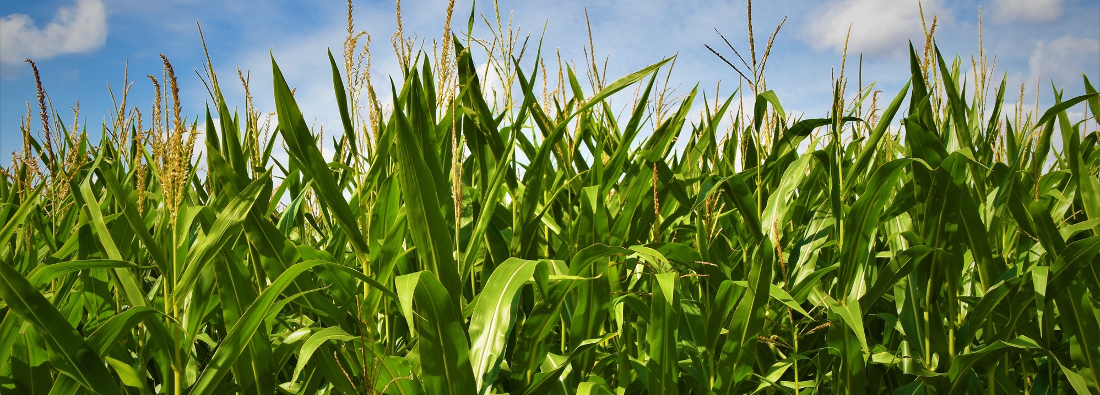
Reliable data on postharvest losses allow donors and other stakeholders to:
Better formulate agricultural policy
Monitor and evaluate loss reduction initiatives and make evidence-based loss reduction investment and policy decisions
Better estimate food supply in particular zones
Identify opportunities to strengthen value chains
Direct their interventions to the most affected geographic areas or areas where impact will be maximized
However, in many countries, reliable data on postharvest losses are scarce
Notes:
Reliable data on where, when, how and to what extent postharvest losses occur can inform investments in loss reduction programmes and agricultural and nutrition programmes in general. Such data allow donors and other stakeholders to:
support the formulation of agricultural policy;
identify opportunities to strengthen value chains;
direct their interventions to the most affected geographic areas or those where impact or efficiency will be maximized;
more reliably estimate food supply in particular zones (food supply = production – PHLs);
monitor and evaluate loss reduction initiatives.
However, in many developing countries, reliable data on postharvest losses are scarce.

Slide 8
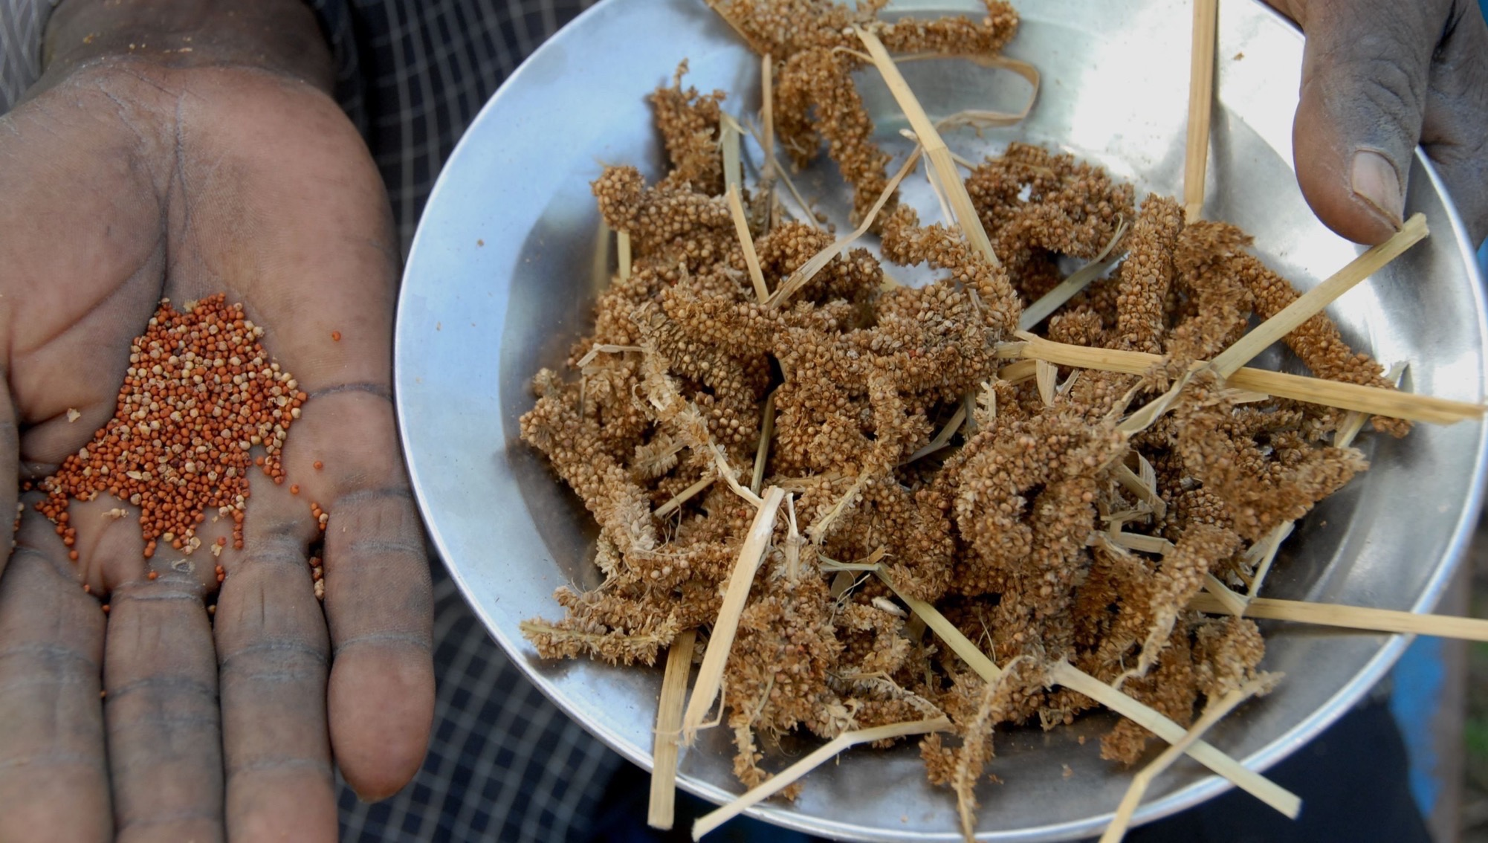
Why are reliable postharvest losses data scarce?
1
2
Data are often based on conjecture rather than on actual measurements
The logic and information sources are not always traceable
3
4
Few studies examine loss along the full value chain
Data sources are unreliable
www.aphlis.net
Notes:
Commonly available data are often based on conjecture;
The logic and information sources are not always traceable, and it is therefore difficult or impossible to judge their accuracy and trustworthiness;
Very few studies follow PHLs along the full value chain (issues of time, space, actors, cost).
Focus has been predominantly on storage losses and on cereals, particularly maize.
Timing: The loss assessment team might not be on site when the farmer decides it is time to harvest.
Data sources may not be very reliable because:
They rarely take climate conditions into account.
They may not give adequate attention to the roles played by women and young people in postharvest activities, thus missing out on valuable information.
They often assume that percentage grain damage is the same as percentage loss.
They use limited and, in some cases, inadequate sampling methodologies and therefore sometimes rely on extreme cases.
They do not indicate time scale or consumption/sales patterns in relation to storage losses.
They often rely on people’s perceptions, which can be biased voluntarily or involuntarily.
As a result, it is difficult to assess the impact that postharvest losses have on smallholder productivity and welfare.

Slide 9
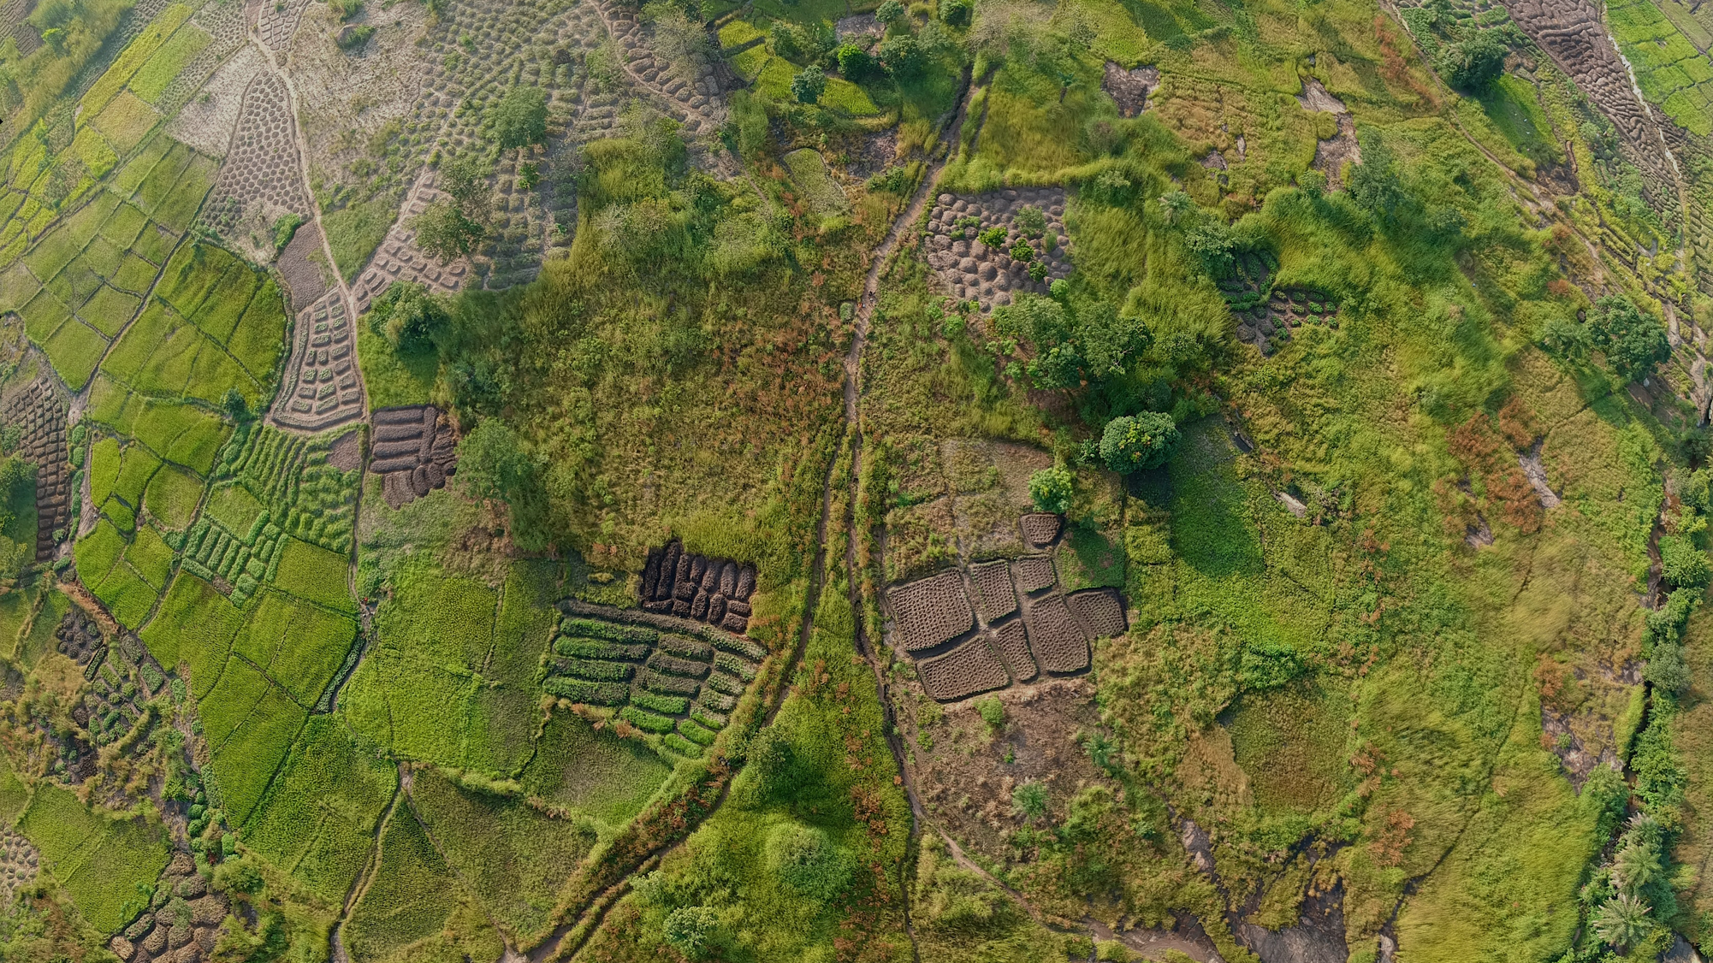
The African Postharvest Losses Information System (APHLIS) is the foremost international effort to collect, analyse and disseminate data on postharvest losses of cereal grains, legumes, roots and tubers in sub-Saharan Africa
Notes:
The African Postharvest Losses Information System (APHLIS) is the foremost international effort to collect, analyze and disseminate data on postharvest losses in sub-Saharan Africa.
Backed by expertise in agricultural research, value chain development, postharvest management, commodity quality analysis, and policy development, APHLIS generates information on the postharvest losses of cereal grains, legumes, roots and tubers.
APHLIS was established in 2009 by the European Commission’s Joint Research Centre. A second phase, known as APHLIS+, got underway in 2016. APHLIS+ is expanding the range of crops covered and includes estimates of the financial and nutritional dimensions of postharvest loss. APHLIS+ is also improving the online, interactive tools for accessing loss data and expanding the African PHL expert network.

Slide 10
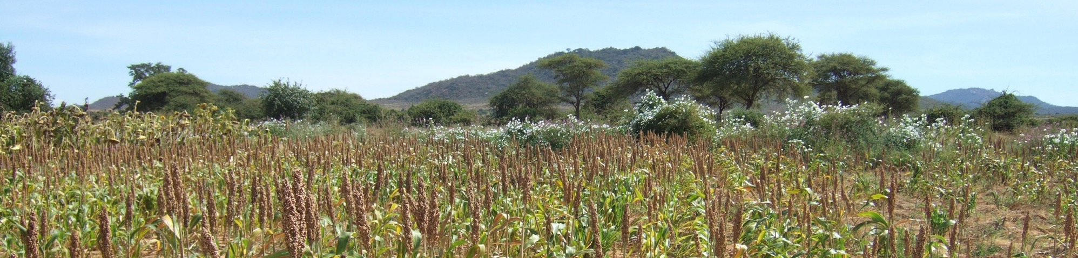
APHLIS objectives
Support
the development of national postharvest losses strategies
Help
countries meet their Malabo and SDG postharvest loss commitments.
Supply
decision-makers with the data they need to determine where and how to focus loss reduction efforts
Improve
the efficiency of value chains and support food security planning
Provide
the basis for monitoring and evaluating loss reduction programmes
Notes:
to support the development of national postharvest losses strategies;
to help countries meet their postharvest loss reduction commitments;
to provide decision-makers with the data they need to determine where and how to focus loss reduction efforts;
to improve the efficiency of value chains and support food security planning;
to provide the basis for monitoring and evaluating loss reduction programmes.

Slide 11

APHLIS extracts PHL data from scientific literature to produce loss estimates at each stage of the postharvest value chain
↓
How APHLIS works →
www.aphlis.net
← To refine the loss estimates, national experts and statistics officers provide context-specific information on:
Subnational production data
Prevalent
pests
Weather conditions
Storage
duration
Percentage marketed
Common PHL loss reduction practices
Notes:
APHLIS calculates postharvest loss estimates per crop and province on an annual basis, supporting countries in developing postharvest loss reduction strategies and helping them to track changes in their loss levels over time as required in Malabo reporting. APHLIS supplies policymakers with the data they need to determine where to focus loss reduction strategies and to improve value chain efficiency and food security. Using a downloadable APHLIS calculator, countries can include further data to fine-tune their loss estimates or to develop or compare loss reduction scenarios. This can assist policymakers in planning, monitoring and evaluating the effectiveness of their initiatives to reduce postharvest losses.
APHLIS bases its loss estimates on two sources of information:
loss data derived from scientific literature, broken down by crop, type of farm and climate; and
local factors, e.g. conditions and practices that can affect losses (production, pests, weather, storage conditions and duration, marketing, loss reduction practices, etc.).
Together, this information enables APHLIS to estimate postharvest losses at the provincial, national and regional levels.
All APHLIS estimates are scientifically rigorous, transparent and freely available on its website: www.aphlis.net

Slide 12
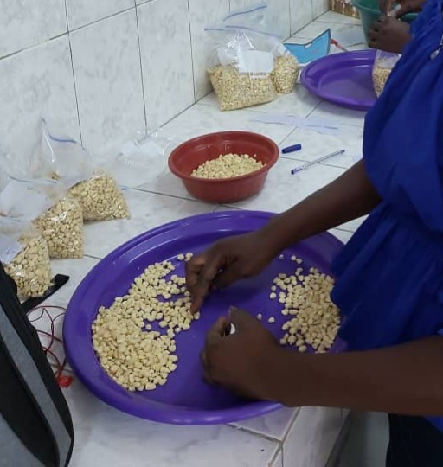
APHLIS loss estimates are:
based on rigorously-measured scientific data
transparent
based on local context (with inputs from local experts)
upgraded as more information becomes available
cost-effective
freely available at www.aphlis.net
www.aphlis.net
Notes:
APHLIS loss estimates are:
based on rigorously-measured scientific data
transparent;
based on context with inputs from local experts;
adjustable year by year;
upgraded as additional high-quality information becomes available;
freely available online.
APHLIS generates information that would be prohibitively expensive to obtain through direct observation and measurement. The APHLIS model uses data provided by network members and derived from scientific literature, replacing extensive and costly loss assessment activities in the field.

Slide 13
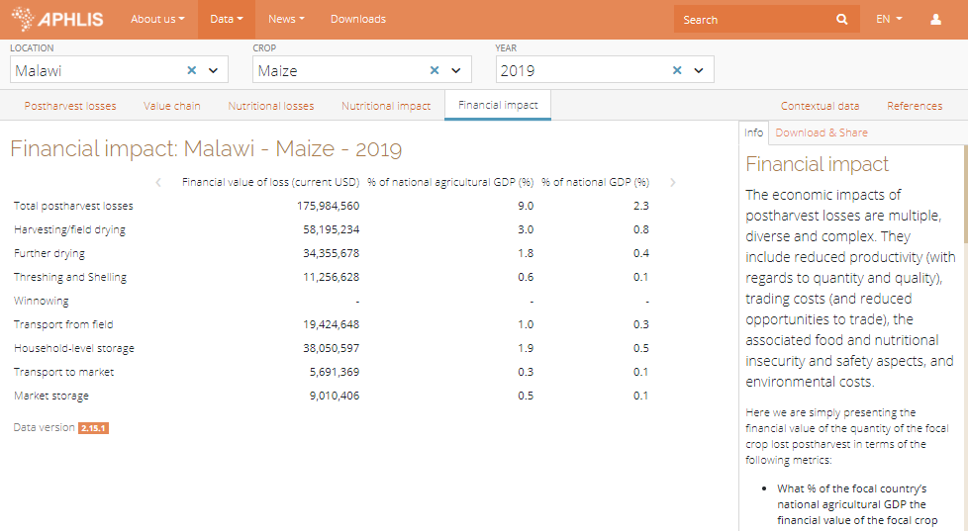
Financial impact
APHLIS determines the financial impact of postharvest loss in terms of:
monetary value of crop loss
percentage of national and agricultural GDP represented by the loss
www.aphlis.net
Notes:
An APHLIS tool estimates the financial value of postharvest losses by multiplying the number of tonnes of a commodity lost each year during postharvest processes in a country (based on APHLIS data) by the price of that commodity.
Additional data show the financial value of postharvest losses as a percentage of national and agricultural GDP.
In Malawi, for example, maize losses in 2019 cost the country almost 176 million USD, around 9 percent of agricultural GDP.

Slide 14
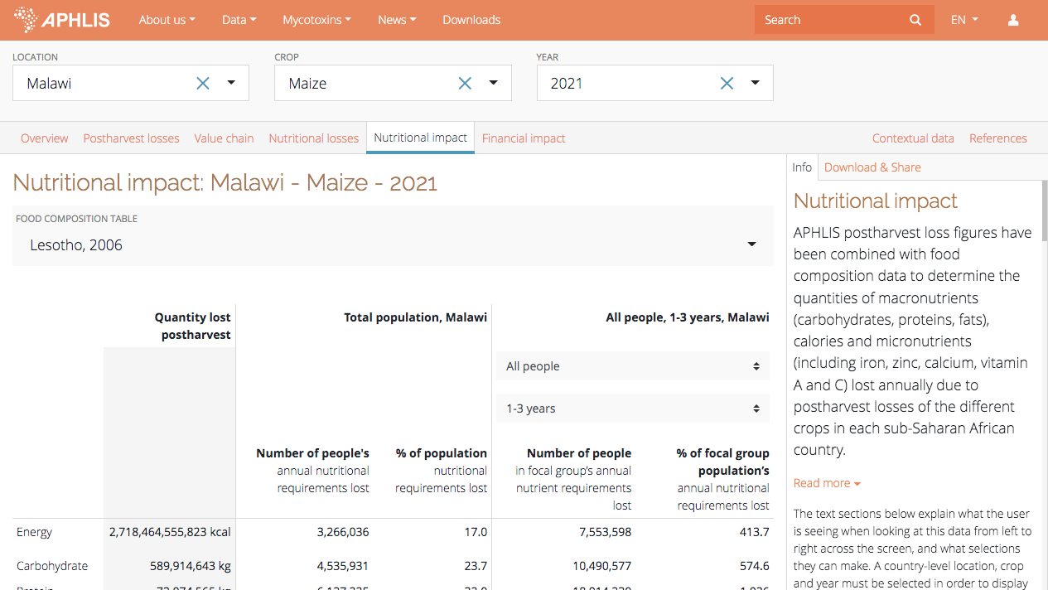
Nutritional impact
APHLIS uses food composition data to determine the quantities of nutrients lost annually during and after harvesting including:
macronutrients (carbohydrates, proteins, fats)
micronutrients (including iron, zinc, calcium, vitamins A and C)
dietary energy (kcals) of the lost food
www.aphlis.net
Notes:
Another APHLIS tool allows users to calculate the nutritional impacts of postharvest losses.
Selecting a particular country and crop, users can learn how much of a given nutrient has been lost per year (starting in 2010) and how many people’s dietary needs were not met as a result.
The tool measures the loss of macronutrients (carbohydrates, proteins, fats), micronutrients (iron, zinc, calcium, vitamins A and C) and dietary energy (kcals).
The calculations consider the dietary requirements of different groups, e.g. women of childbearing age, young children).
Here, for example, maize losses in Malawi in 2021 meant that more than 7.5 million children from 1 to 3 years of age did not meet their energy requirements from local maize.
Nutritional loss information is available at national and subnational levels.

Slide 15
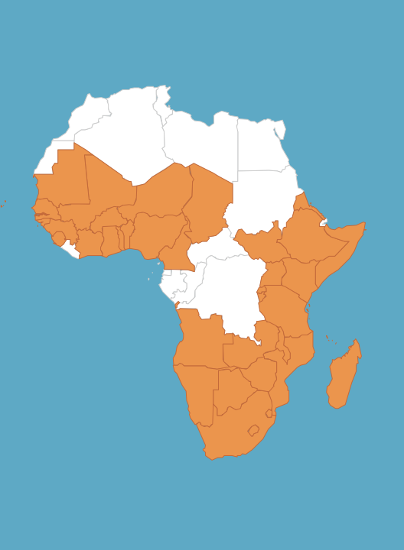
The APHLIS Network
The APHLIS Network comprises postharvest loss experts from sub-Saharan African countries, who:
provide contextual information to increase the accuracy of estimates
provide seasonal crop production data
submit country narratives to provide context about their postharvest systems
provide technical and advisory support for national efforts around Malabo implementation
act as ambassadors for APHLIS
Notes:
The APHLIS network currently includes postharvest loss experts from 40 African countries and is constantly working to expand its coverage.
Network members:
provide context-based information to increase the accuracy of estimates (e.g. damp weather at harvest, percentage of crop retained on farm for storage, length of storage period, number of harvests);
provide seasonal crop production data;
submit country narratives to provide detail on their PH systems;
support national efforts around Malabo implementation;
act as APHLIS ‘ambassadors.’

Slide 16
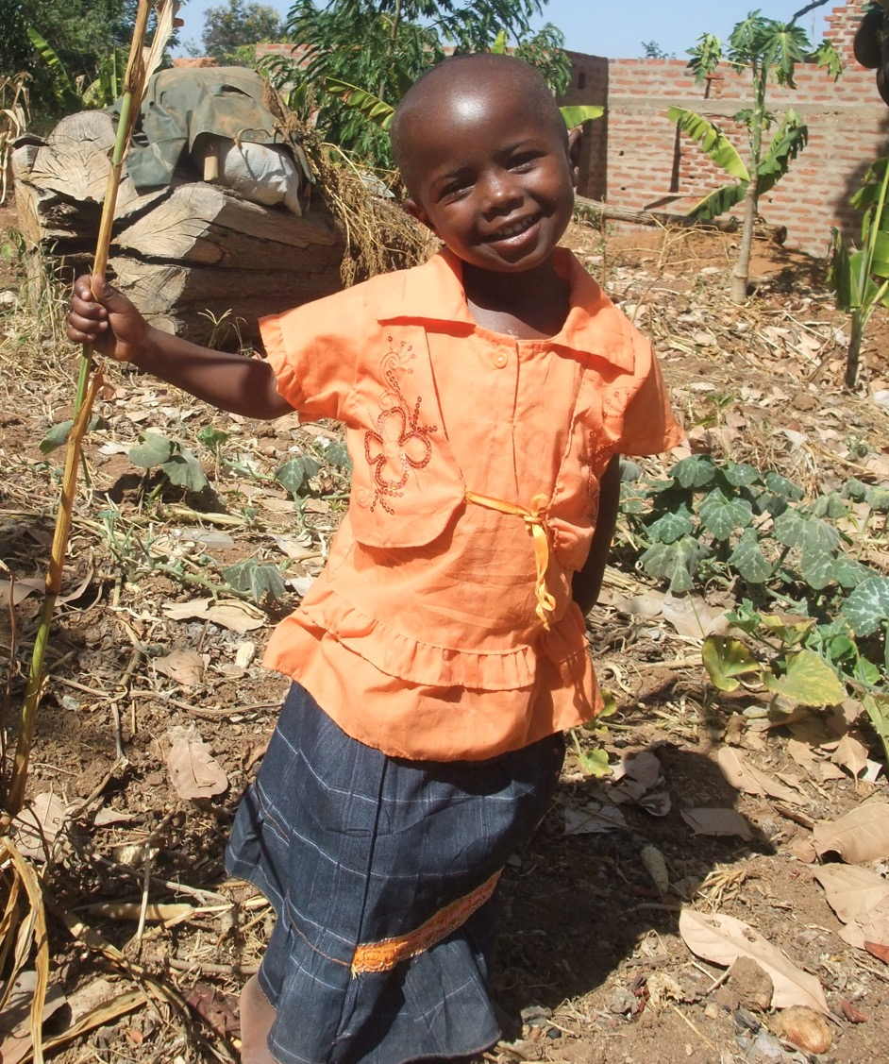
What’s ahead for APHLIS
An expanded scope that includes additional crops and countries
Recognition as the key source of reliable PHL estimate information for supporting decisions and reporting by governments and the private sector
Analysis of trends to support agricultural policy formulation and loss reduction activities
A community of practice that fosters a flow of information between PHL stakeholders
Notes:
Continued efforts to ensure an accessible and user-friendly information system;
The inclusion of additional crops and countries;
Analysis of trends to support agricultural policy formulation and loss reduction activities;
Global recognition of APHLIS as the key source of reliable PHL estimate information for supporting and influencing decisions by governments and the private sector;
Support for an active community of practice that fosters a flow of information between PHL stakeholders.

Slide 17
Thank you!
For further information, please contact any of the following:
info@aphlis.net
Cephas Taruvinga cephas.taruvinga@aphlis.net
Gideon Onumah g.e.onumah@greenwich.ac.uk
Brighton Mvumi mvumibm@hotmail.com or mvumibm@agric.uz.ac.zw
Tanya Stathers t.e.stathers@greenwich.ac.uk

